Slide 1
Vue JS 시작하기

Slide 2
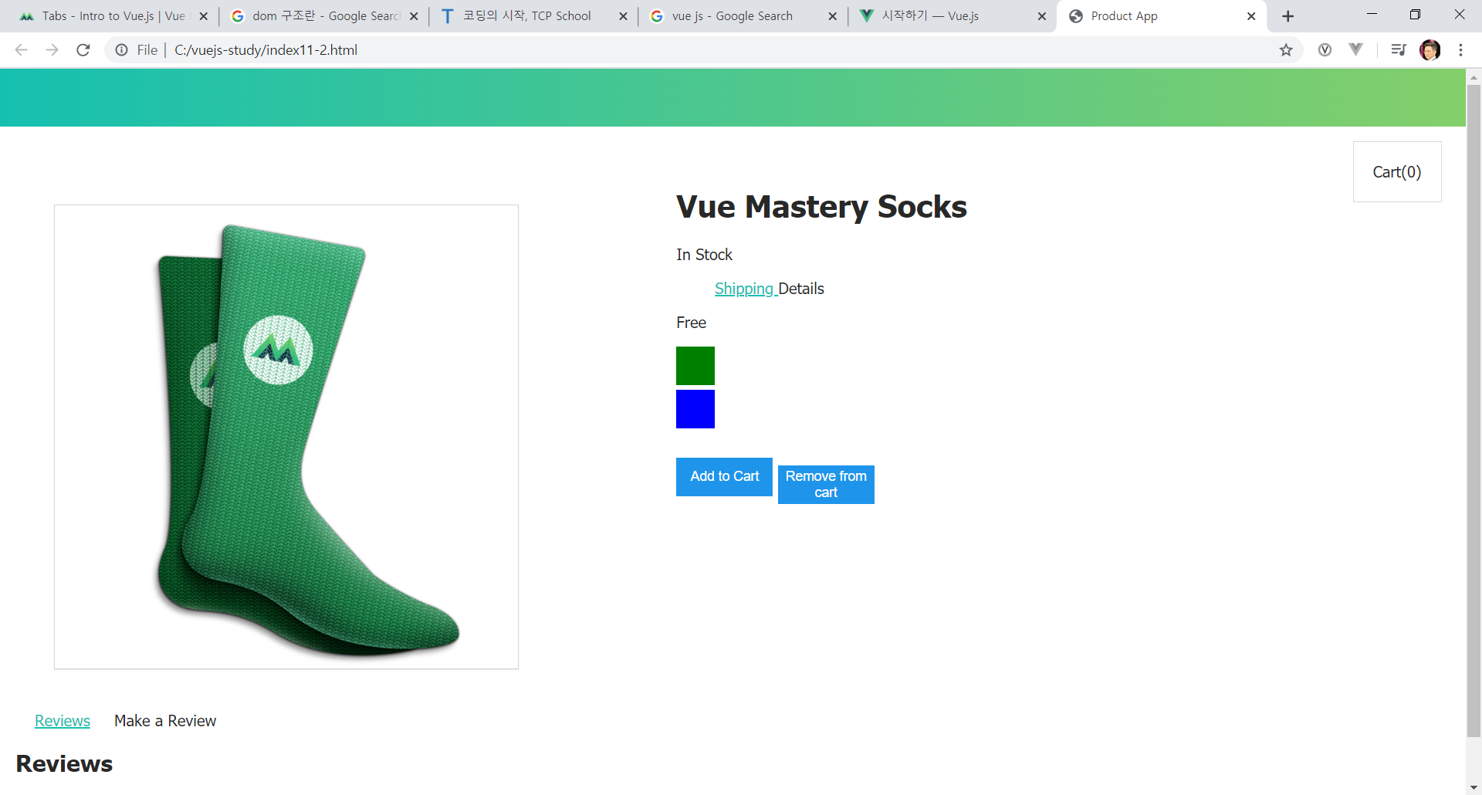

Slide 3
Vue Instance 제작하기

Slide 4
1 – startVue.html
<!DOCTYPE html>
<html>
<head>
<title>My first Vue app</title>
<!-- 상용버전, 속도와 용량이 최적화됨. -->
<script src="https://cdn.jsdelivr.net/npm/vue"></script>
</head>
<body>
<div id="app">
안녕하세요 </br>
{{ message }}
</div>
<script>
var app = new Vue({
el: '#app',
data: {
message: 'Hello Vue!'
}
})
</script> <script src="1 - startVue.js"></script>
</body>
</html>

Slide 5
1 – startVue.js
var app = new Vue({
el: '#app2',
data: {
message: '안녕하세요 Vue!',
discription: ‘설명란입니다.'
}
})

Slide 6
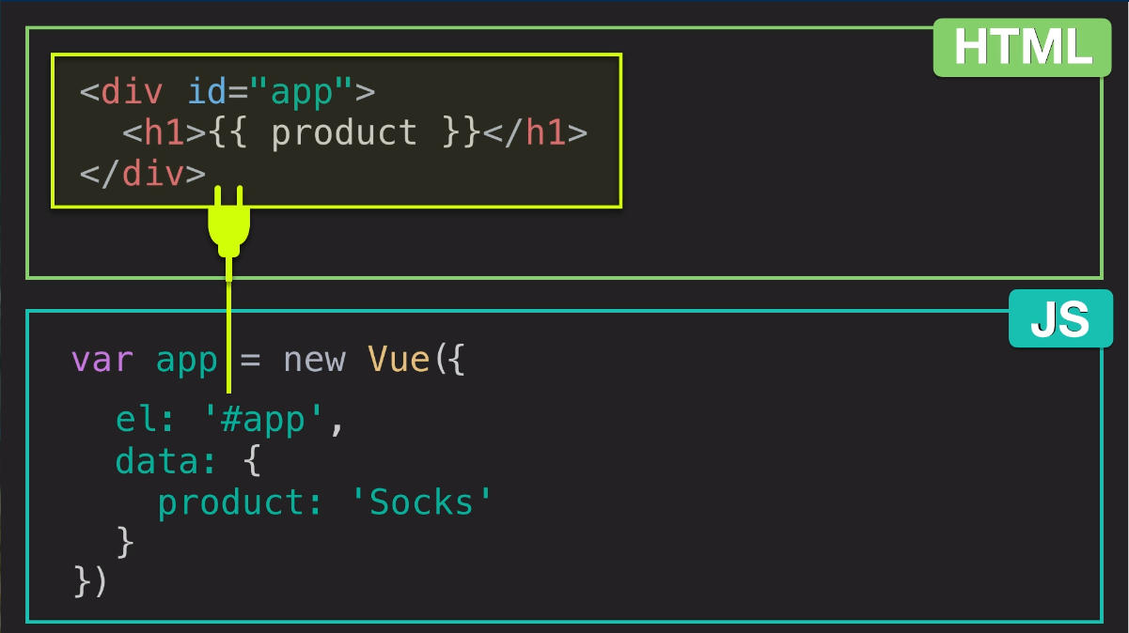

Slide 7
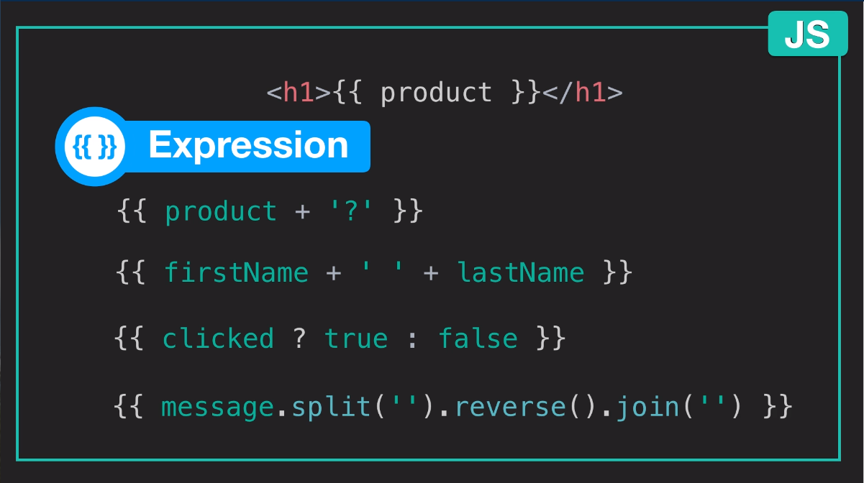

Slide 8
Downloads Asset
http://bitly.kr/oPtDny1D5A

Slide 9
Index1.html
<!DOCTYPE html>
<html>
<head>
<title>Product App</title>
<link rel="styleshhet" type="text/css" href="style.css">
</head>
<body>
<div id="app">
<div class="product-info">
<h1>{{ product }}</h1>
<!-- <h2>{{ discription }}</h2> -->
</div>
</div>
<script src="https://cdn.jsdelivr.net/npm/vue@2.5.13/dist/vue.js"></script>
<script src="index1.js"></script>
</body>
</html>

Slide 10
Index1.js
//Add a description to the data object with the value "A pair of warm, fuzzy socks". Then display the description using an expression in an p element, underneath the h1.
var app = new Vue({
el: '#app',
data: {
product: 'Socks'
// ,discription: 'Socks is footwear'
}
})

Slide 11
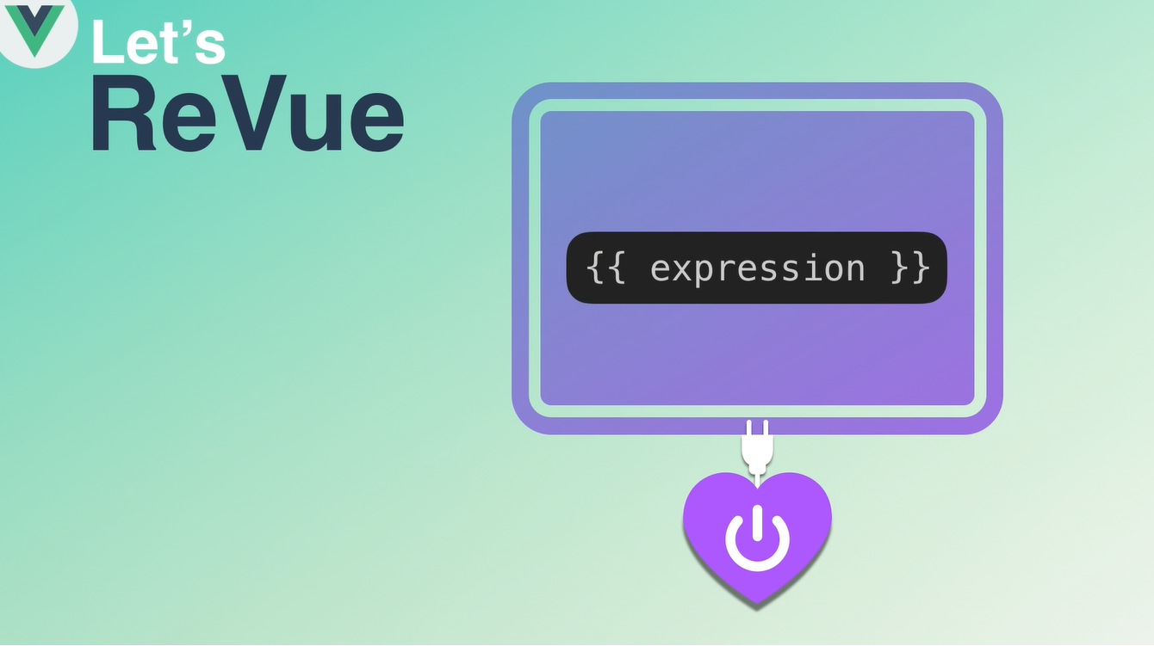
Vue instance 는 dom내의 plug-in {{ expression }} 을 사용할 수 있게 하고 instance data로 변경해 줌

Slide 12
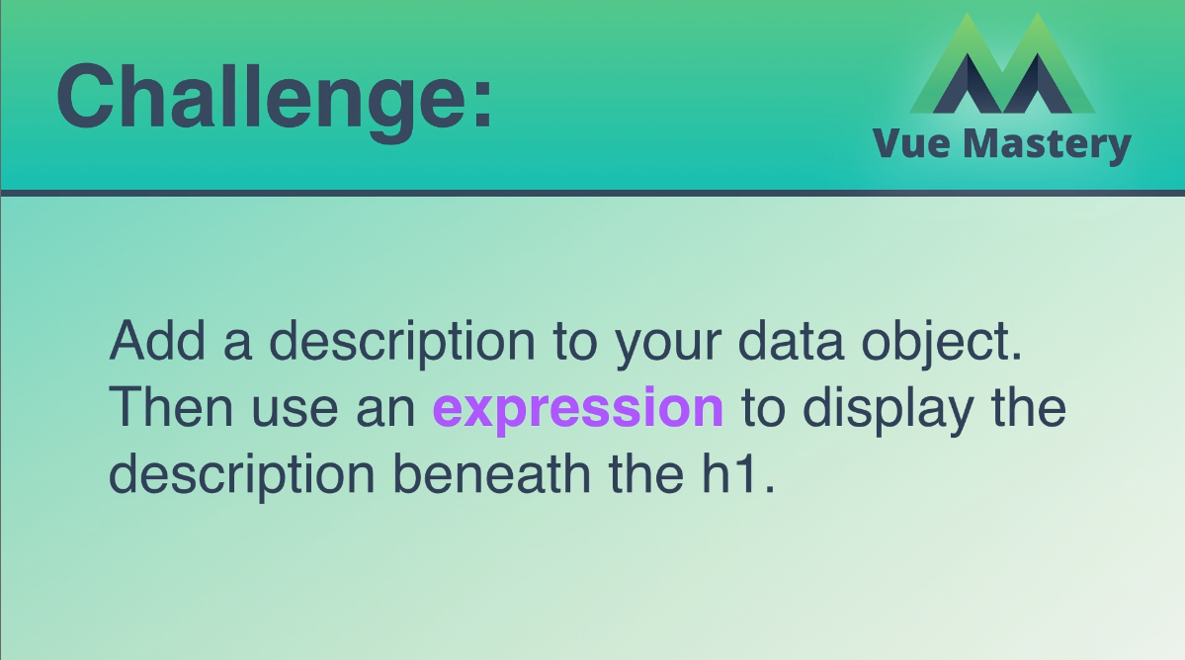
데이터 오브젝트에 설명을 추가하십시오.
그런 다음 expression을 사용하여
H1 태그 안에 설명을 표시하십시오.

Slide 13
Attribute Binding
Index2.html, Index2.js

Slide 14
Index2.html
<!DOCTYPE html>
<html>
<head>
<title>Product App</title>
<link rel="stylesheet" type="text/css" href="style.css">
</head>
<body>
<div class="nav-bar"></div>
<div id="app">
<div class="product">
<div class="product-image">
<img v-bind:src="image" />
<!-- <img :src="image2" :alt="altText"/> -->
</div>
<div class="product-info">
<h1>{{ product }}</h1>
<h2>{{ discription }}</h2>
</div>
</div>
</div>
<script src="https://cdn.jsdelivr.net/npm/vue@2.5.13/dist/vue.js"></script>
<script src="index2.js"></script>
</body>
</html>

Slide 15
Index2.js
var app = new Vue({
el: '#app',
data: {
product: 'Socks',
discription: 'Socks is footwear',
image: "./assets/vmSocks-green-onWhite.jpg",
altText: "A pair of socks"
}
})

Slide 16
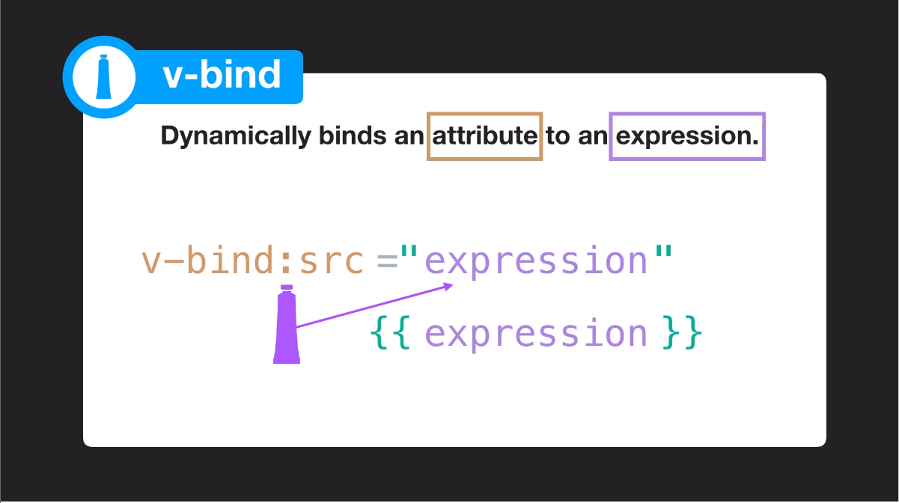

Slide 17
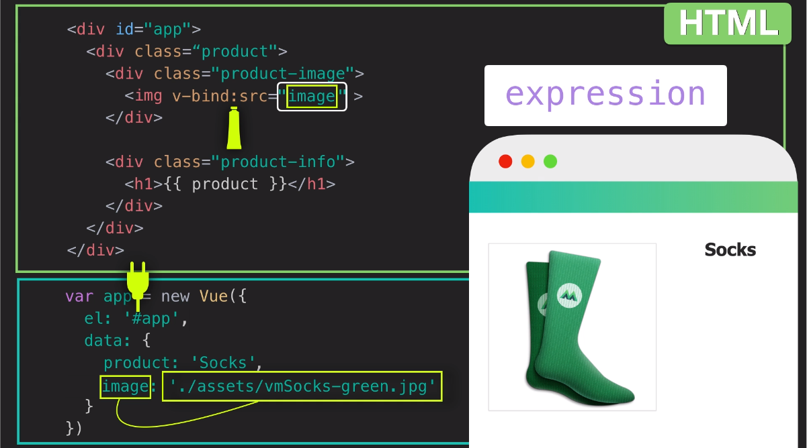

Slide 18


Slide 19


Slide 20
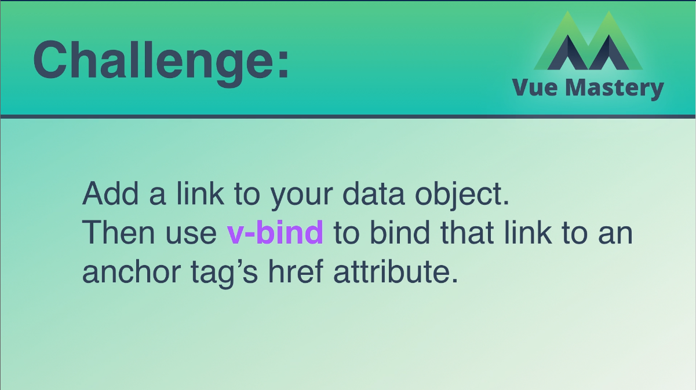
데이터 객체에 link ( 아무 곳이나, ex: naver.com) 를 추가하십시오.
그런 다음 v-bind를 사용하여 해당 링크를
anchor 태그의 href 속성에 binding하십시오.

Slide 21
Conditional Rendering
Index3.html, Index3.js
<!DOCTYPE html>
<html>
<head>
<title>Product App</title>
<link rel="stylesheet" type="text/css" href="style.css">
</head>
<body>
<div class="nav-bar"></div>
<div id="app">
<div class="product">
<div class="product-image">
<img v-bind:src="image" />
</div>
<div class="product-info">
<h1>{{ product }}</h1>
<p v-if="inStock">In Stock</p>
<p v-else>Out of Stock</p>
</div>
</div>
</div>
<script src="https://cdn.jsdelivr.net/npm/vue@2.5.13/dist/vue.js"></script>
<script src="index3-1.js"></script>
</body>
</html>

Slide 22
Index3.js
//Add a description to the data object with the value "A pair of warm, fuzzy socks". Then display the description using an expression in an p element, underneath the h1.
var app = new Vue({
el: '#app',
data: {
product: 'Socks',
discription: 'Socks is footwear',
image: "./assets/vmSocks-green-onWhite.jpg",
image2: "./assets/vmSocks-blue-onWhite.jpg",
altText: "A pair of socks",
inStock: true,
inventory: 6
}
})

Slide 23
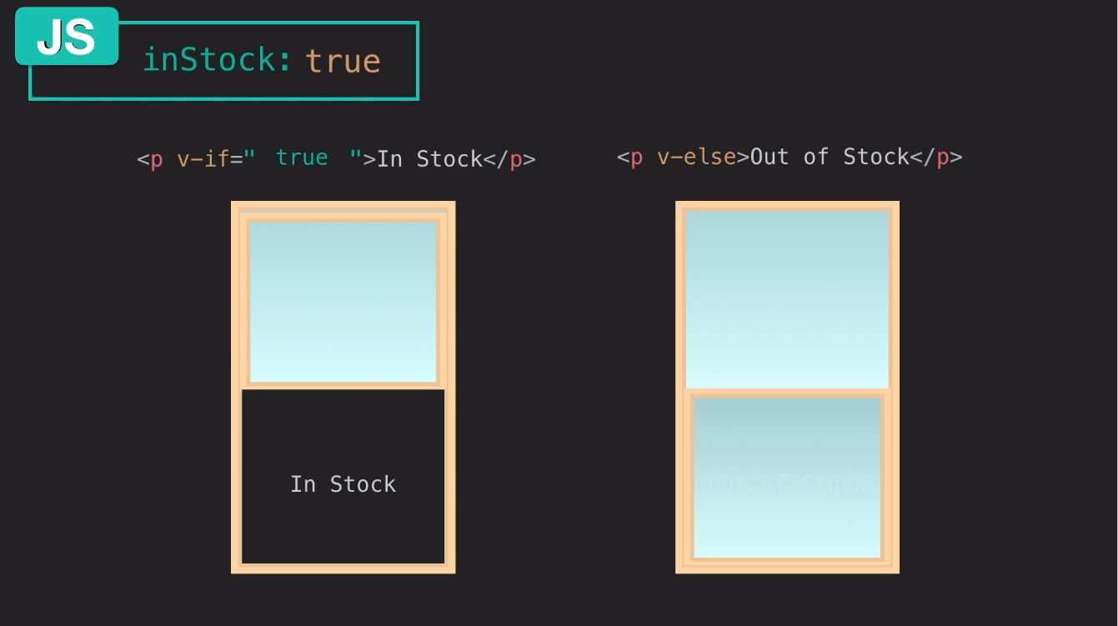

Slide 24
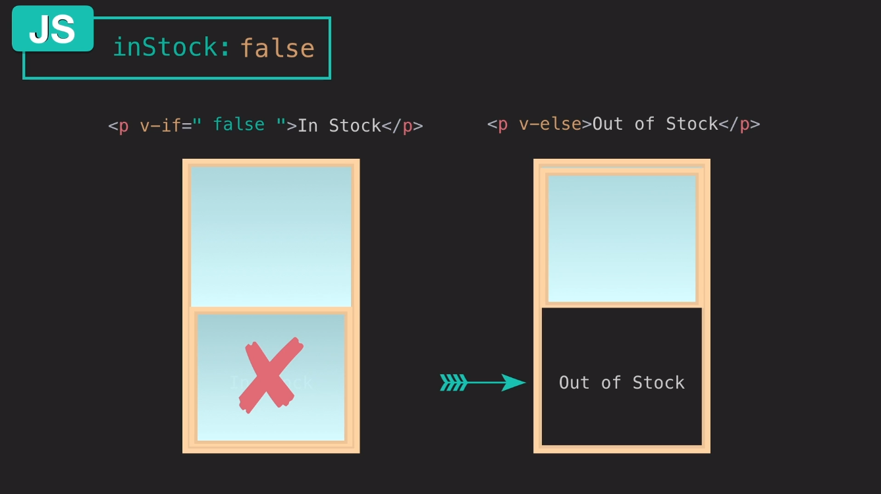

Slide 25
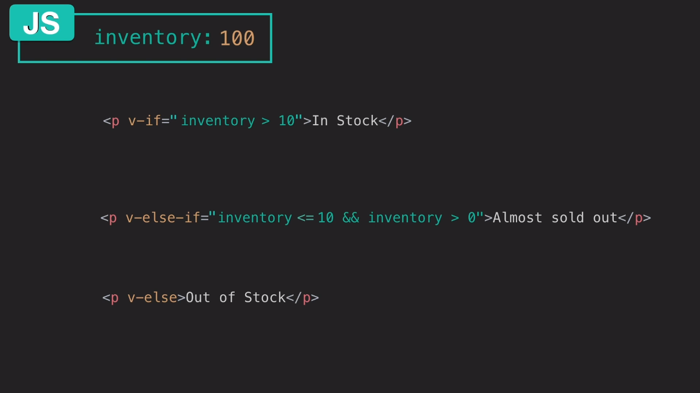

Slide 26
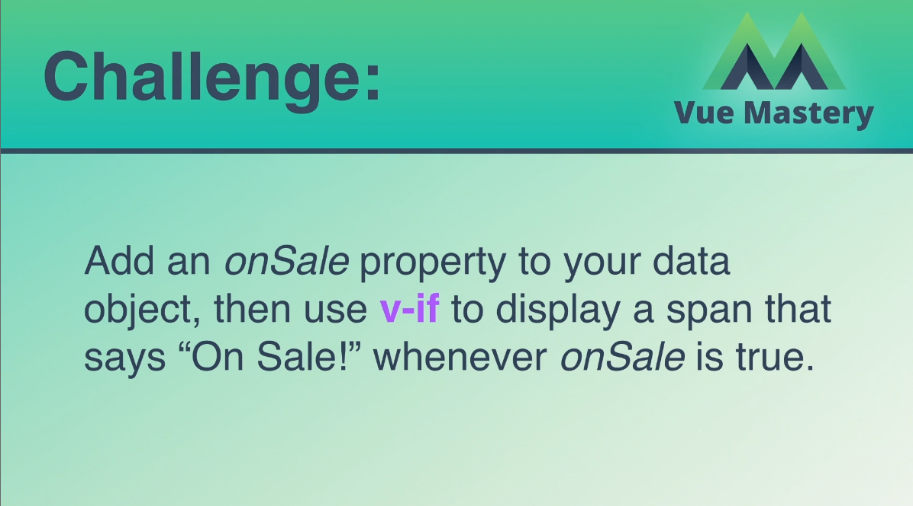
데이터 객체에 onSale 속성을 추가 한 다음
v-if를 사용하여 "On Sale!“을 표시합니다.
onSale이 true 일 때만 표시합니다.

Slide 27
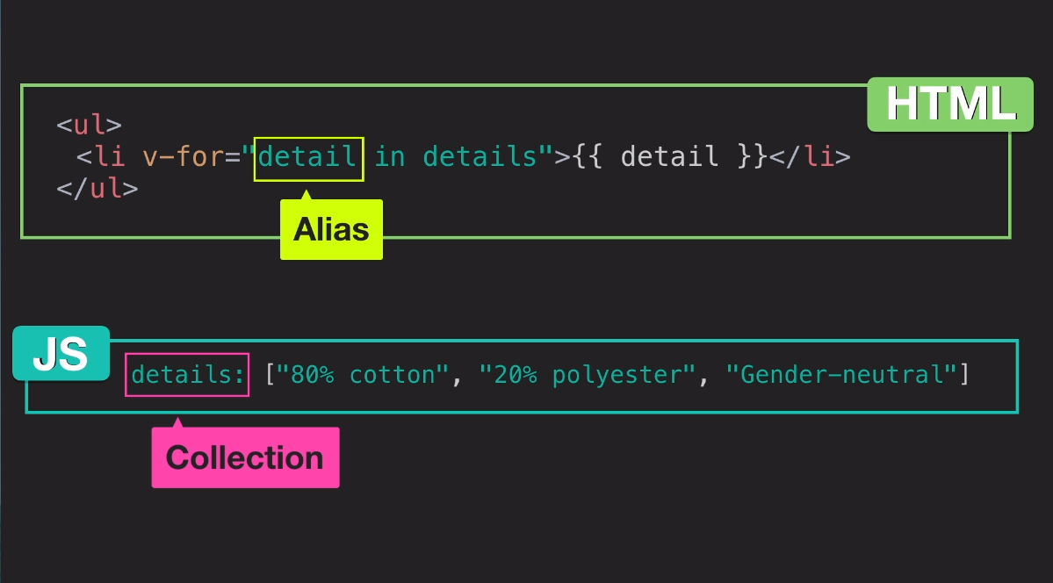

Slide 28
List Rendering
Index4.html, Index4.js
<!DOCTYPE html>
<html>
<head>
<title>Product App</title>
<link rel="stylesheet" type="text/css" href="style.css">
</head>
<body>
<div class="nav-bar"></div>
<div id="app">
<div class="product">
<div class="product-image">
<img v-bind:src="image" />
</div>
<div class="product-info">
<h1>{{ product }}</h1>
<p v-if="inStock">In Stock</p>
<p v-else>Out of Stock</p>
<ul>
<li v-for="detail in details">{{ detail }}</li>
</ul>
<div v-for="variant in variants" :key="variant.variantId">
<p> {{ variant.variantColor }}</p>
</div>
</div>
</div>
</div>
<script src="https://cdn.jsdelivr.net/npm/vue@2.5.13/dist/vue.js"></script>
<script src="index4.js"></script>
</body>
</html>

Slide 29
Index4.js
//Add a description to the data object with the value "A pair of warm, fuzzy socks". Then display the description using an expression in an p element, underneath the h1.
var app = new Vue({
el: '#app',
data: {
product: 'Socks',
discription: 'Socks is footwear',
image: "./assets/vmSocks-green-onWhite.jpg",
image2: "./assets/vmSocks-blue-onWhite.jpg",
altText: "A pair of socks",
inStock: true,
inventory: 6,
onSale: false,
details: ['80% cotton', '20% polyester', 'Gender-neutral'],
variants: [
{
variantId: 2234,
variantColor: "green"
},
{
variantId: 2235,
variantColor: "blue"
}
]
}
})

Slide 30
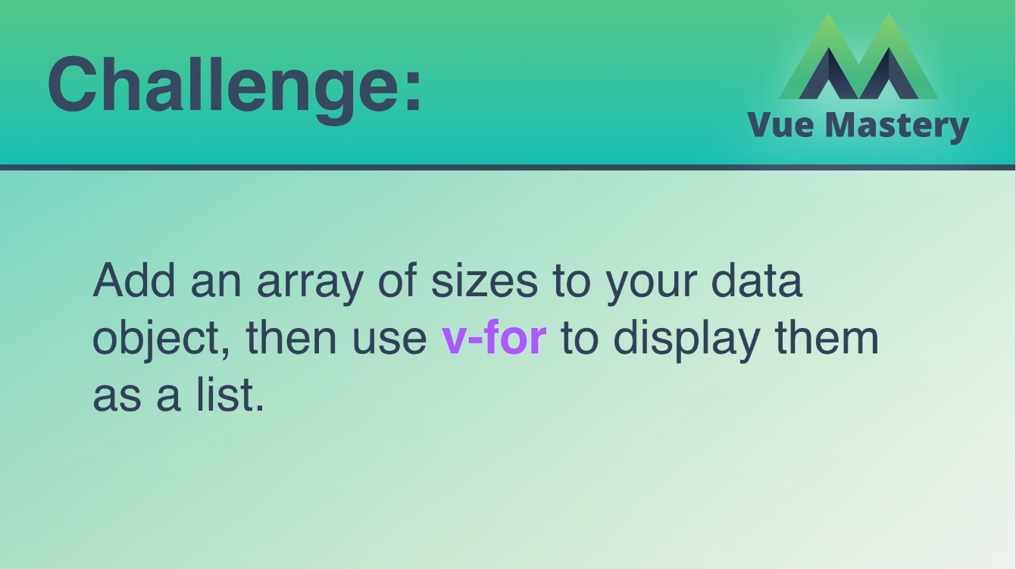
데이터 객체에 배열을 추가 한 다음
v-for를 사용하여 list로 표시하십시오.

Slide 31
Event Handling
Index5.html, Index5.js
<!DOCTYPE html>
<html>
<head>
<title>Product App</title>
<link rel="stylesheet" type="text/css" href="style.css">
</head>
<body>
<div class="nav-bar"></div>
<div id="app">
<div class="product">
<div class="product-image">
<img :src="image“ :alt=“altText" />
</div>
<div class="product-info">
<h1>{{ product }}</h1>
<p v-if="inStock">In Stock</p>
<p v-else>Out of Stock</p>
<ul>
<li v-for="detail in details">{{ detail }}</li>
</ul>
<div v-for="variant in variants" :key="variant.variantId">
<p @mouseover="updateProduct(variant.variantImage)"> {{ variant.variantColor }}</p>
</div>
<!-- <button v-on:click="cart += 1">Add to Cart</button> -->
<button v-on:click="addToCart">Add to Cart</button>
<div class="cart">
<p>Cart({{cart}})</p>
</div>
</div>
</div>
</div>
<script src="https://cdn.jsdelivr.net/npm/vue@2.5.13/dist/vue.js"></script>
<script src="index5.js"></script>
</body>
</html>

Slide 32
Index5.js
//Add a description to the data object with the value "A pair of warm, fuzzy socks". Then display the description using an expression in an p element, underneath the h1.
var app = new Vue({
el: '#app',
data: {
product: 'Socks',
discription: 'Socks is footwear',
image: "./assets/vmSocks-green-onWhite.jpg",
image2: "./assets/vmSocks-blue-onWhite.jpg",
altText: "A pair of socks",
inStock: true,
inventory: 6,
onSale: false,
details: ['80% cotton', '20% polyester', 'Gender-neutral'],
variants: [
{
variantId: 2234,
variantColor: "green",
variantImage: './assets/vmSocks-green-onWhite.jpg'
},
{
variantId: 2235,
variantColor: "blue",
variantImage: './assets/vmSocks-blue-onWhite.jpg'
}
],
cart: 0
},
methods: {
// addToCart: function () {
// this.cart += 1
// },
// updateProduct: function (variantImage) {
// this.image = variantImage
// }
addToCart() {
this.cart += 1
},
updateProduct(variantImage) {
this.image = variantImage
}
}
})

Slide 33
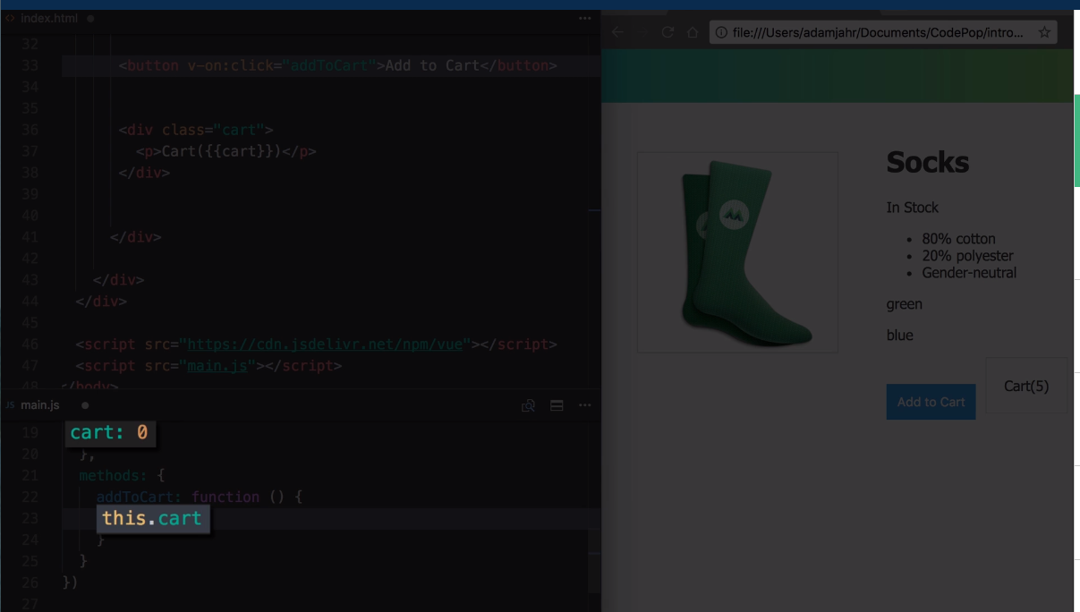

Slide 34
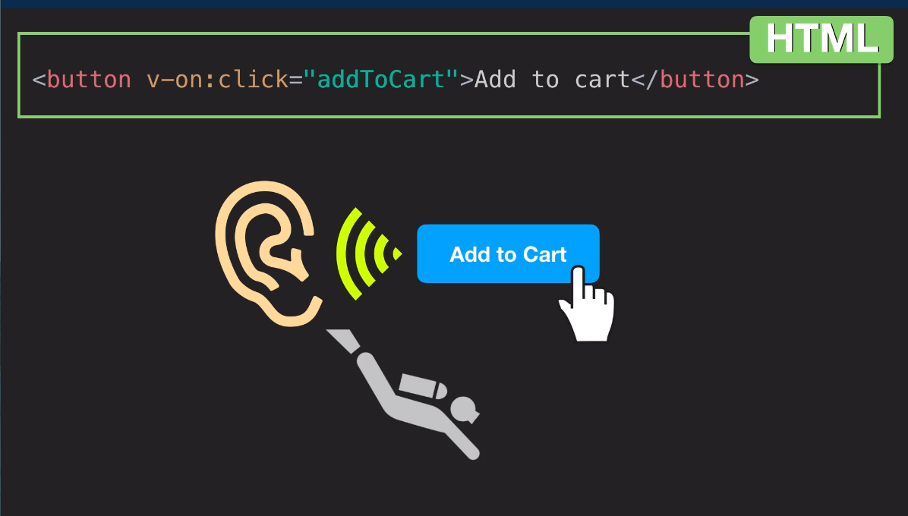

Slide 35
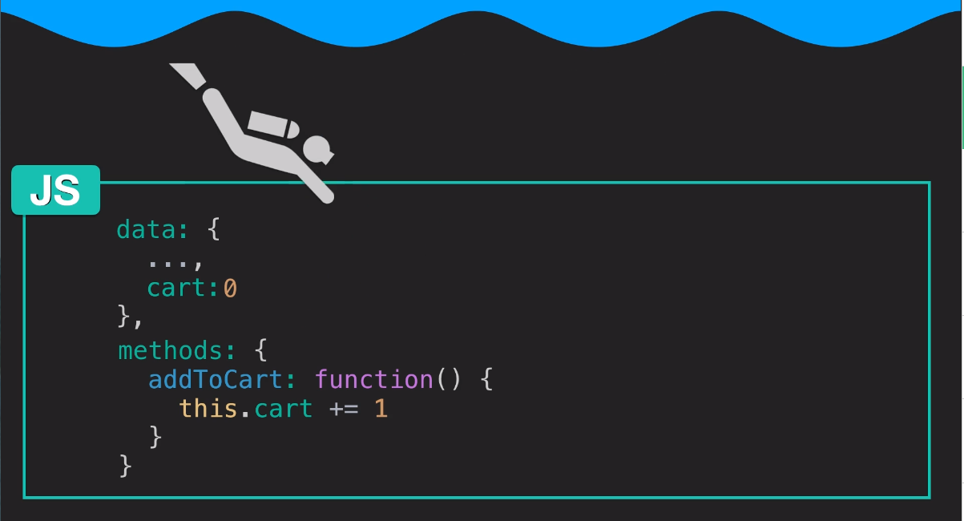

Slide 36
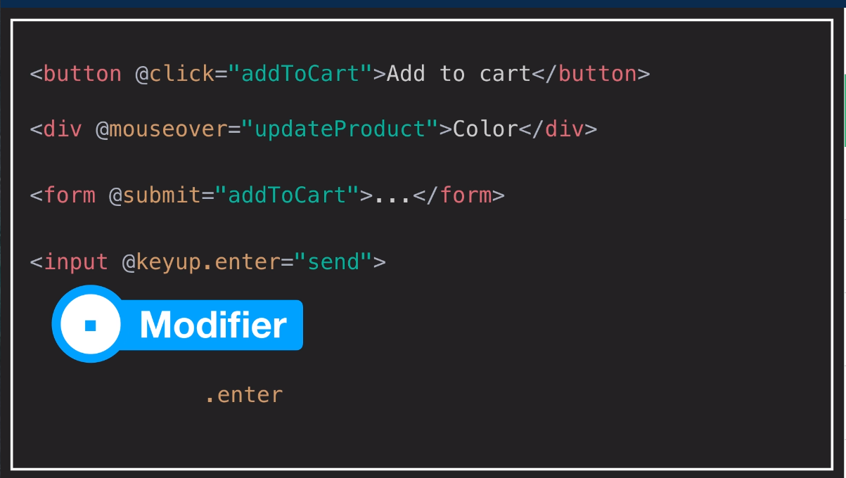

Slide 37
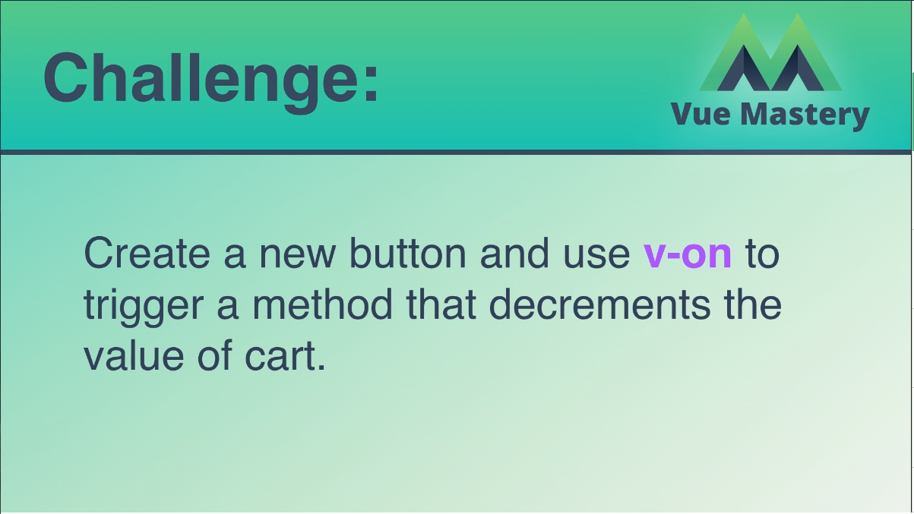
새 버튼을 만들고 v-on을 사용하여
카트의 값을 줄이는 method을 연결하십시오.

Slide 38
Class & Style Binding
Index6.html, Index6.js
<!DOCTYPE html>
<html>
<head>
<title>Product App</title>
<link rel="stylesheet" type="text/css" href="style2.css">
</head>
<body>
<div class="nav-bar"></div>
<div id="app">
<div class="product">
<div class="product-image">
<img v-bind:src="image" />
<!-- <img :src="image2" :alt="altText"/> -->
</div>
<div class="product-info">
<h1>{{ product }}</h1>
<p v-if="inStock">In Stock</p>
<p v-else>Out of Stock</p>
<ul>
<li v-for="detail in details">{{ detail }}</li>
</ul>
<div v-for="variant in variants"
:key="variant.variantId"
class="color-box"
:style="{ backgroundColor: variant.variantColor }"
@mouseover="updateProduct(variant.variantImage)">
</div>
<button v-on:click="addToCart"
:disabled="!inStock"
:class="{ disabledButton: inventory <= 0 }">Add to Cart</button>
<button v-on:click="removeFromCart"
:class="{ disabledButton: cart <= 0 }">Remove from cart</button>
<div class="cart">
<p>Cart({{cart}})</p>
</div>
</div>
</div>
</div>
<script src="https://cdn.jsdelivr.net/npm/vue@2.5.13/dist/vue.js"></script>
<script src="index6.js"></script>
</body>
</html>

Slide 39
Index6.js
//Add a description to the data object with the value "A pair of warm, fuzzy socks". Then display the description using an expression in an p element, underneath the h1.
var app = new Vue({
el: '#app',
data: {
product: 'Socks',
discription: 'Socks is footwear',
image: "./assets/vmSocks-green-onWhite.jpg",
image2: "./assets/vmSocks-blue-onWhite.jpg",
altText: "A pair of socks",
inStock: true,
inventory: 11,
onSale: false,
details: ['80% cotton', '20% polyester', 'Gender-neutral'],
variants: [
{
variantId: 2234,
variantColor: "green",
variantImage: './assets/vmSocks-green-onWhite.jpg'
},
{
variantId: 2235,
variantColor: "blue",
variantImage: './assets/vmSocks-blue-onWhite.jpg'
}
],
cart: 0
},
methods: {
addToCart() {
this.cart += 1
},
updateProduct(variantImage) {
this.image = variantImage
},
removeFromCart() {
if (this.cart > 0) {
this.cart -= 1
}
}
}
})

Slide 40
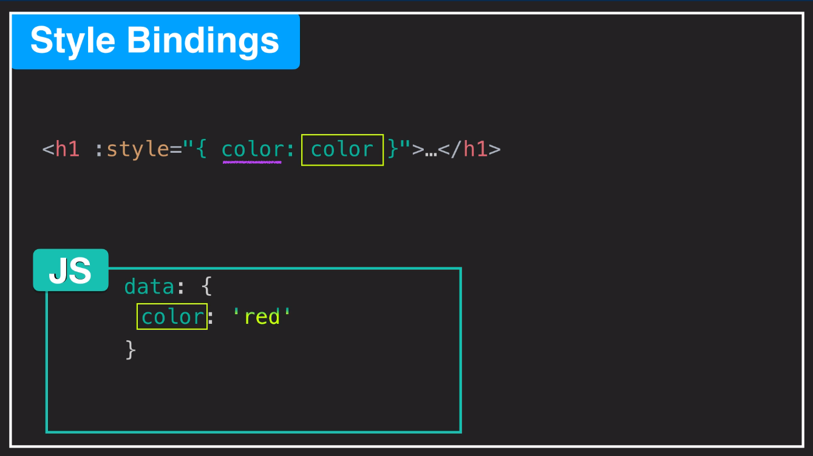

Slide 41
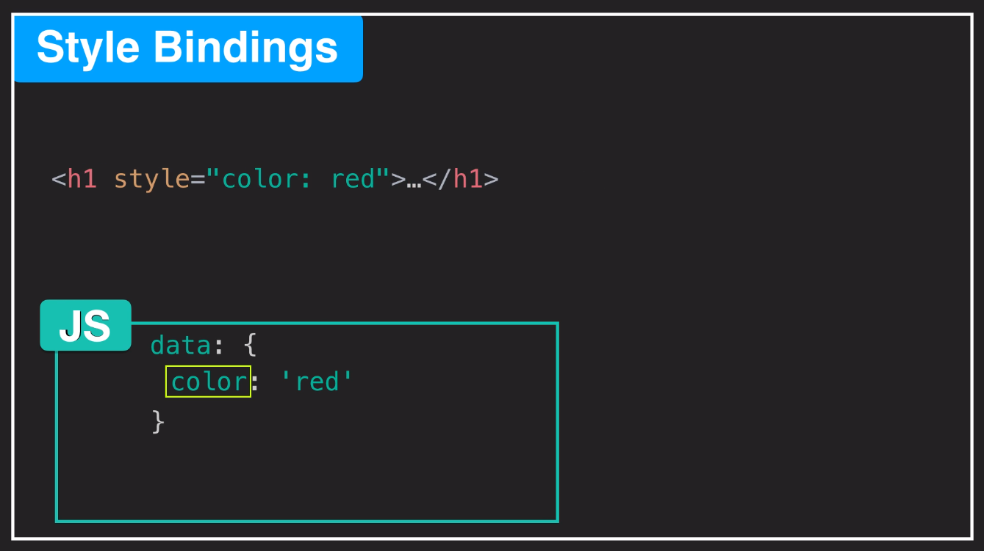

Slide 42
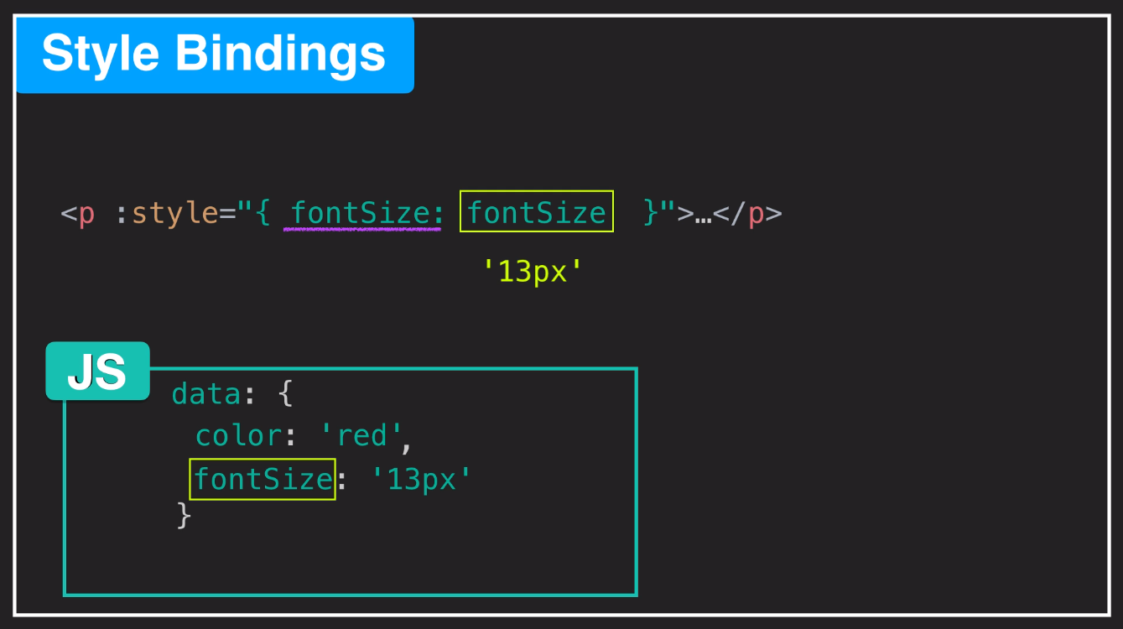

Slide 43
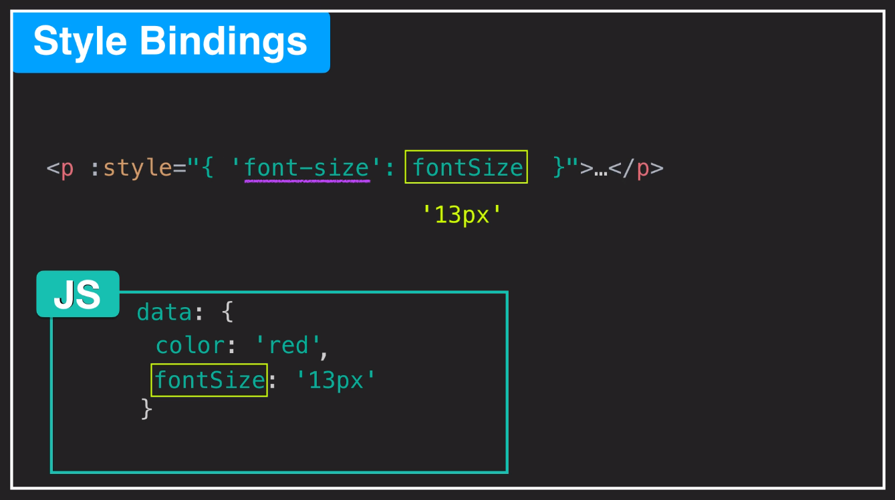

Slide 44
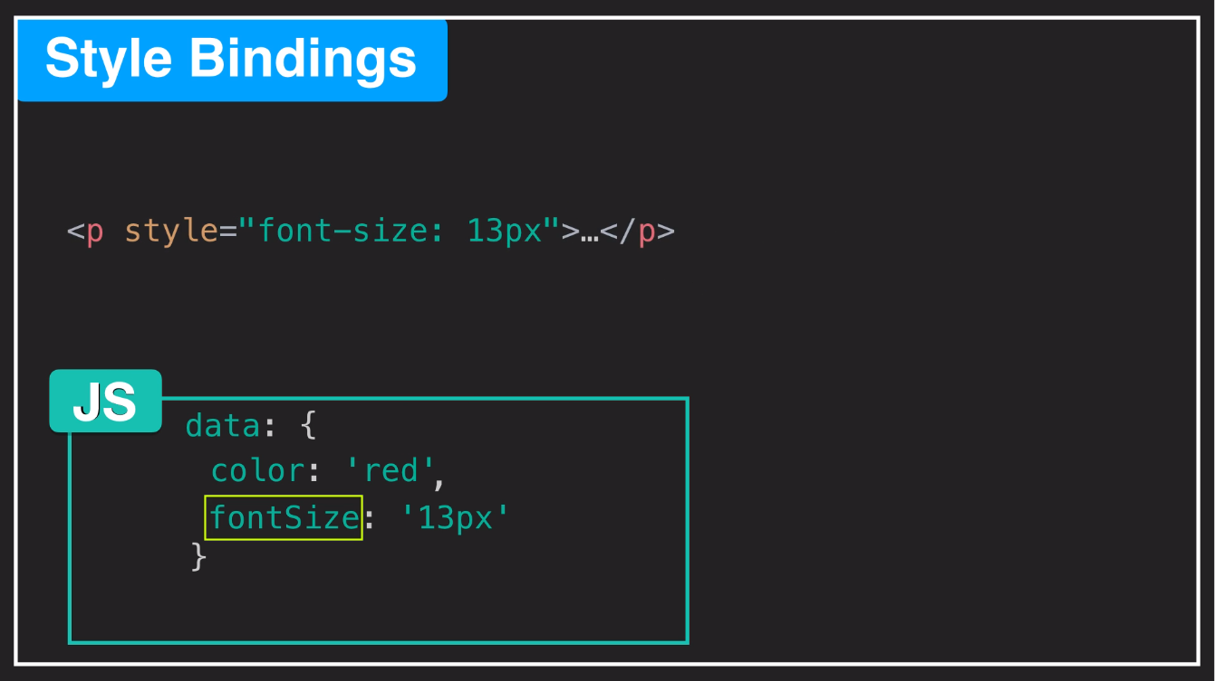

Slide 45
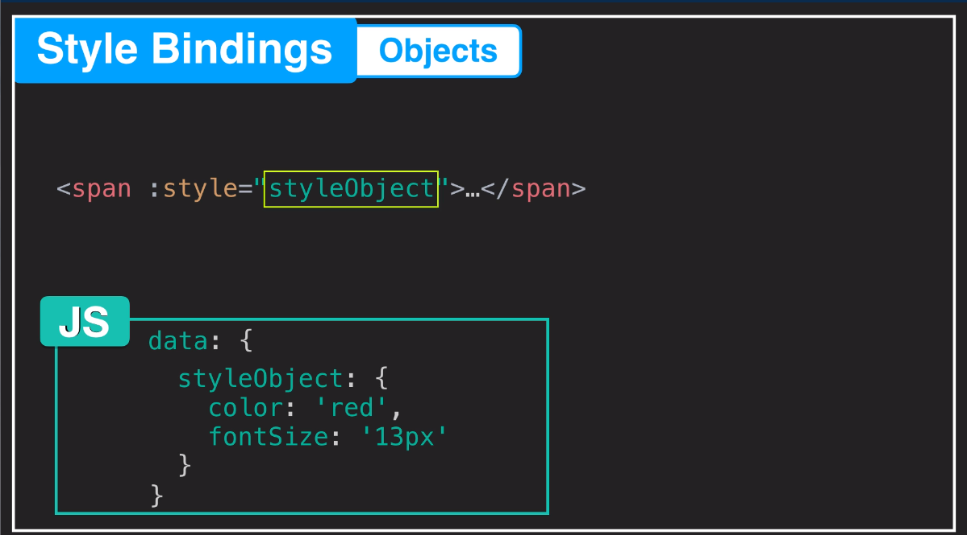

Slide 46
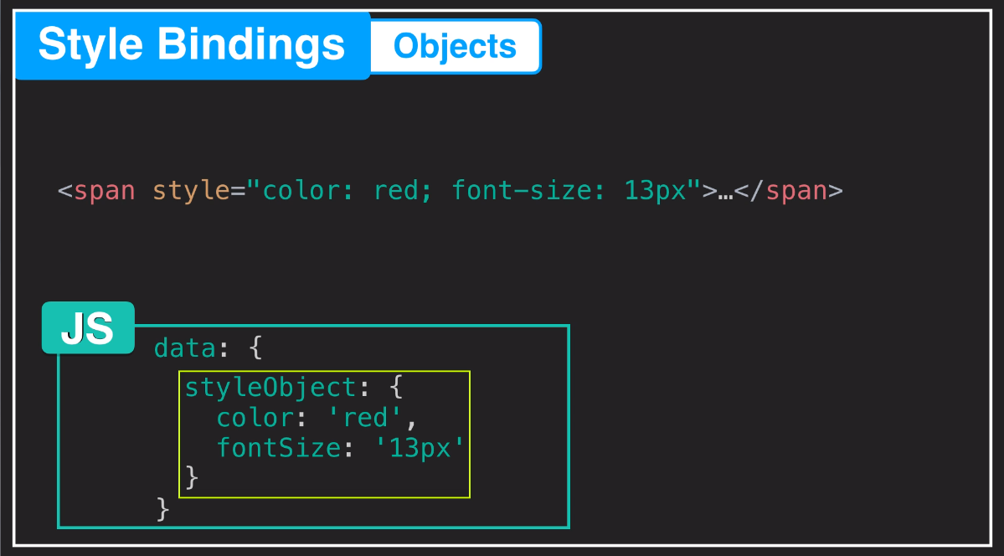

Slide 47
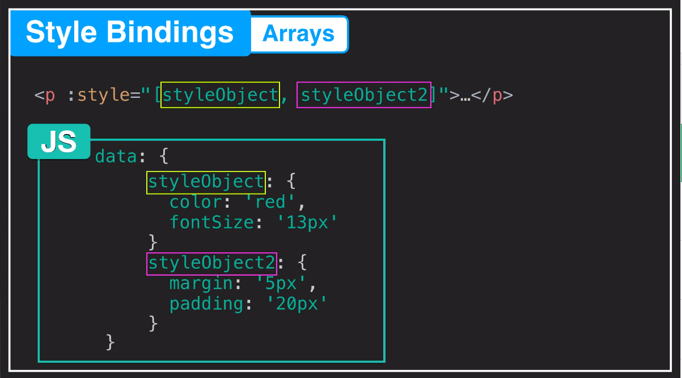

Slide 48
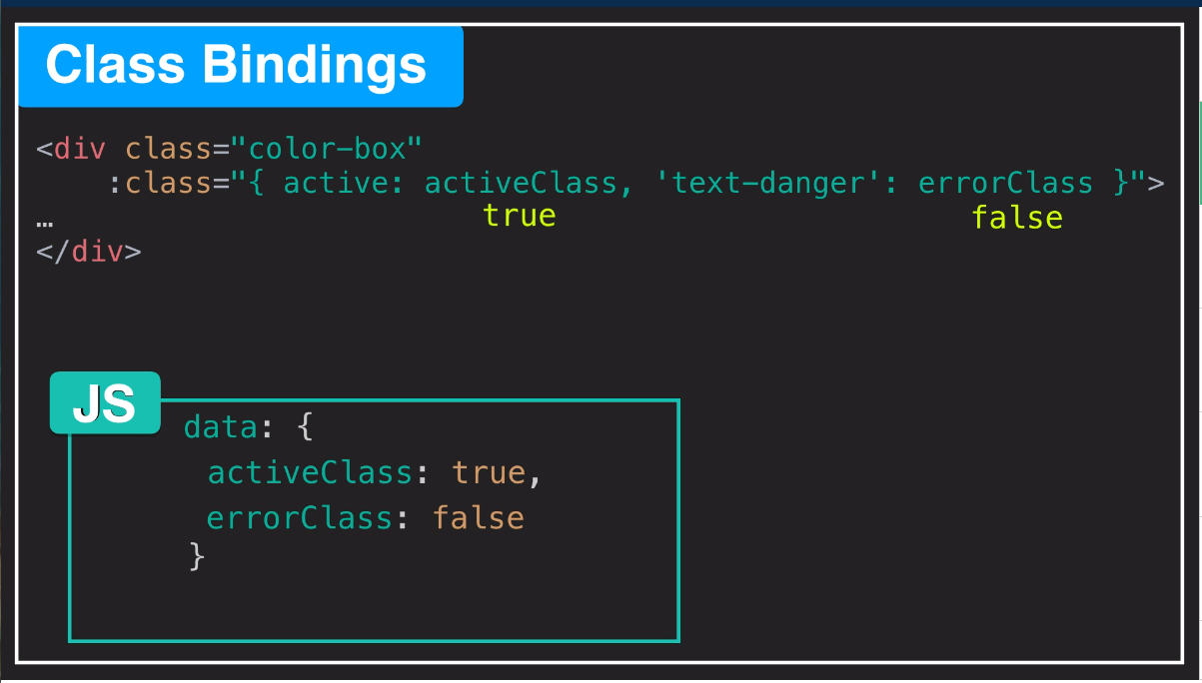

Slide 49
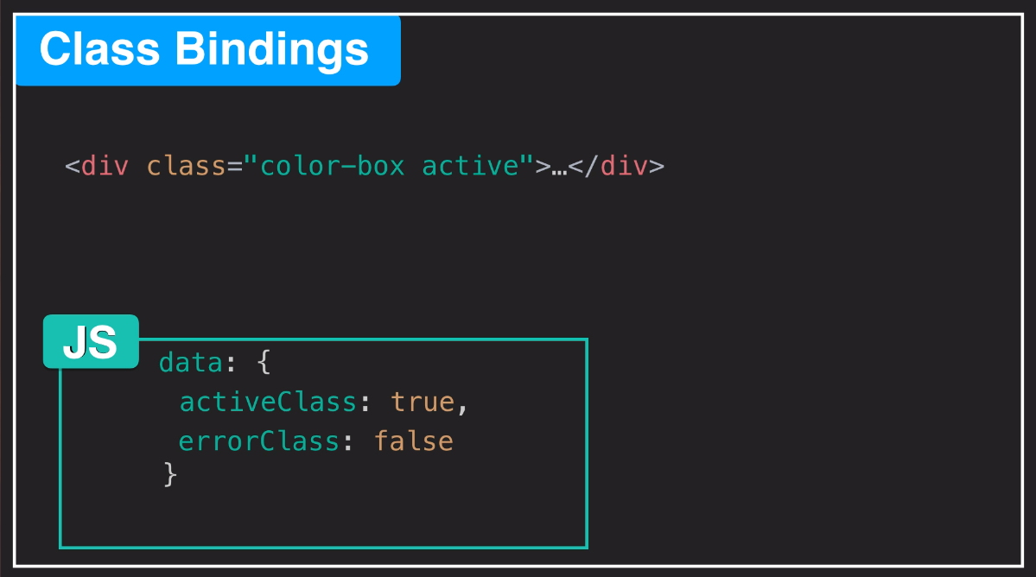

Slide 50
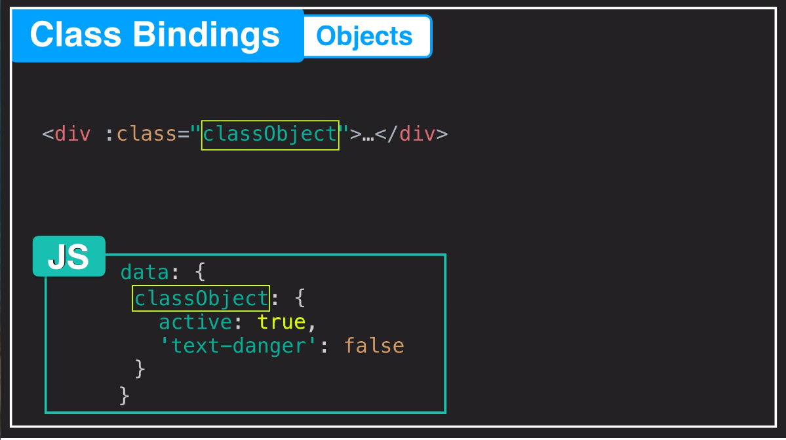

Slide 51


Slide 52
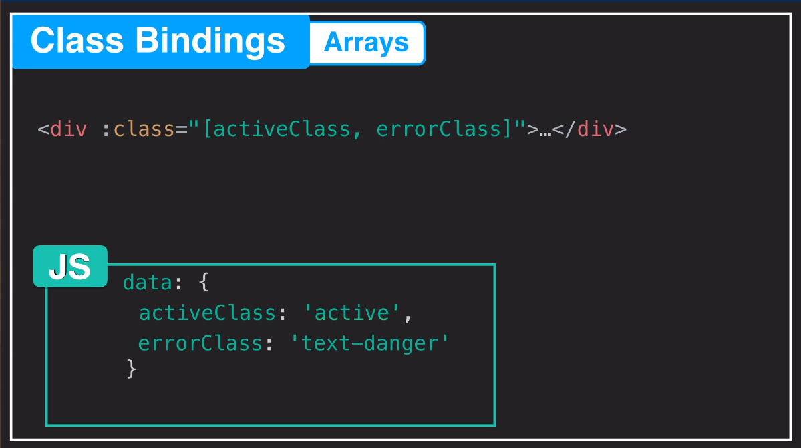

Slide 53
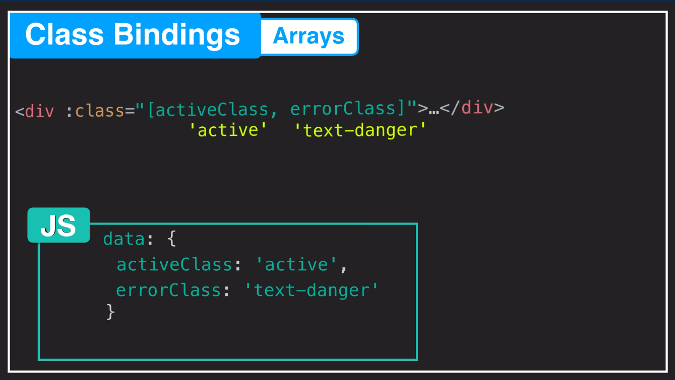

Slide 54
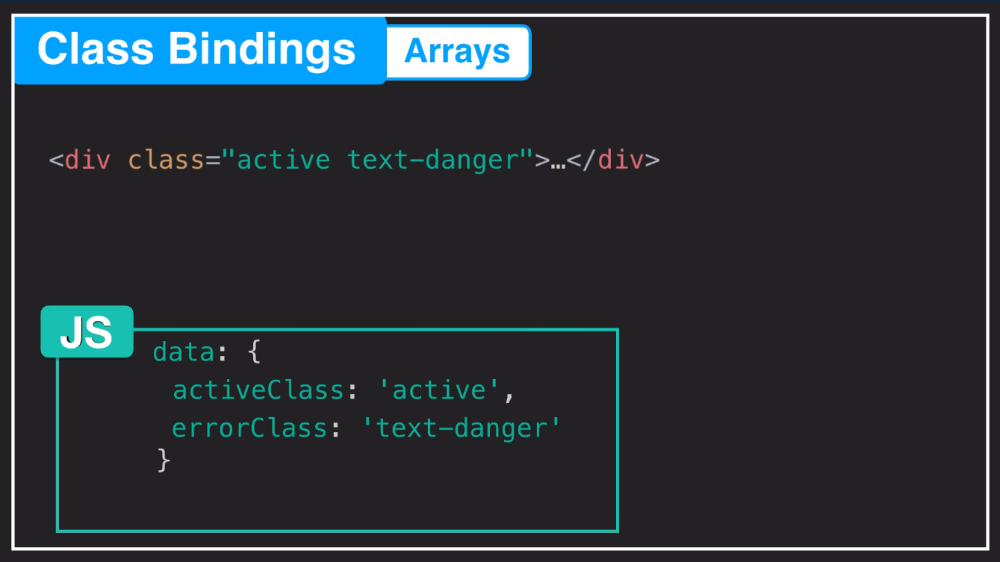

Slide 55
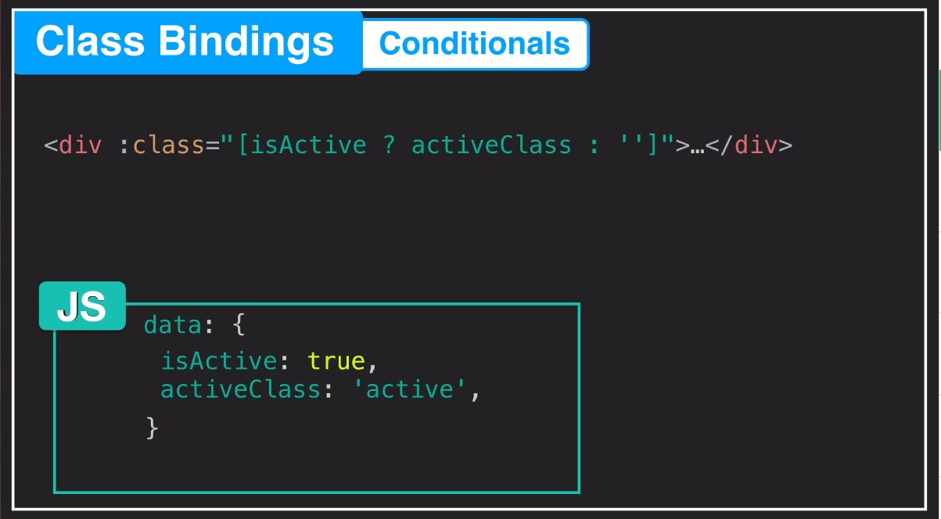

Slide 56
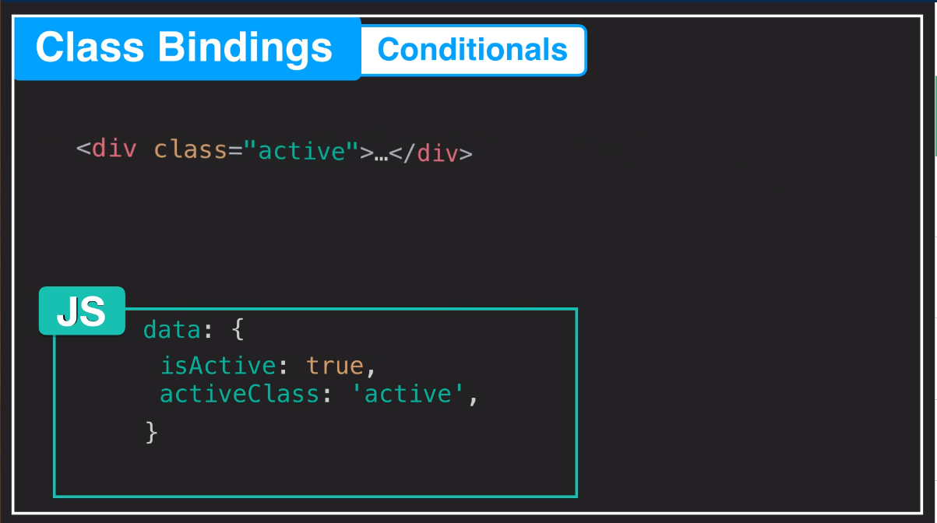

Slide 57
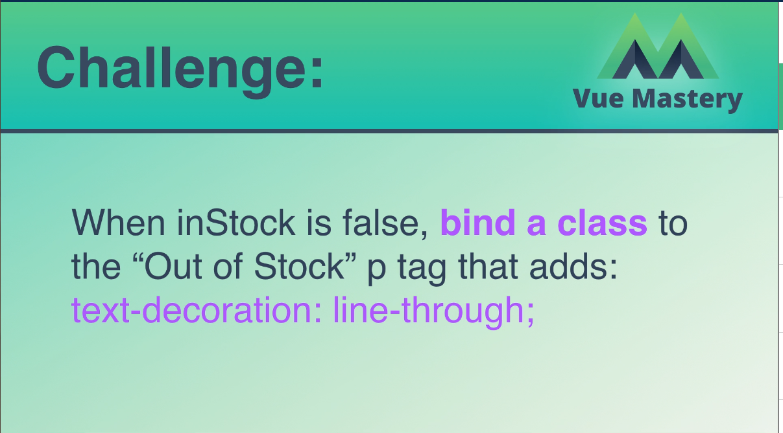
inStock이 false 인 경우,
“Out Of Stock” p 태그에 class를 바인딩하십시오.
해당 클래스는 아래의 css 속성을 가집니다.
text-decoration : line-through.

Slide 58
Computed Properties
Index7.html, Index7.js
<!DOCTYPE html>
<html>
<head>
<title>Product App</title>
<link rel="stylesheet" type="text/css" href="style2.css">
</head>
<body>
<div class="nav-bar"></div>
<div id="app">
<div class="product">
<div class="product-image">
<img v-bind:src="image" />
</div>
<div class="product-info">
<h1>{{ brand }} {{ product }}</h1>
<!-- <h1>{{ title }}</h1> -->
<p v-if="inStock">In Stock</p>
<p v-else
:class="{ outOfStock: !inStock }">Out of Stock</p>
<ul>
<li v-for="detail in details">{{ detail }}</li>
</ul>
<!-- <div v-for="variant in variants" -->
<div v-for="(variant, index) in variants"
:key="variant.variantId"
class="color-box"
:style="{ backgroundColor: variant.variantColor }"
@mouseover="updateProduct(index)">
<!-- <p> {{ variant.variantColor }}</p> -->
<!-- <p @mouseover="updateProduct(variant.variantImage)"> {{ variant.variantColor }}</p> -->
</div>
<button v-on:click="addToCart"
:disabled="!inStock"
:class="{ disabledButton: !inStock }">Add to Cart</button>
<button v-on:click="removeFromCart"
:class="{ disabledButton: cart <= 0 }">Remove from cart</button>
<div class="cart">
<p>Cart({{cart}})</p>
</div>
</div>
</div>
</div>
<script src="https://cdn.jsdelivr.net/npm/vue@2.5.13/dist/vue.js"></script>
<script src="index7.js"></script>
</body>
</html>

Slide 59
Index7.js
//Add a description to the data object with the value "A pair of warm, fuzzy socks". Then display the description using an expression in an p element, underneath the h1.
var app = new Vue({
el: '#app',
data: {
brand: 'Vue Mastery',
product: 'Socks',
discription: 'Socks is footwear',
// image: "./assets/vmSocks-green-onWhite.jpg",
selectedVariant: 0,
altText: "A pair of socks",
// inStock: true,
// inventory: 11,
onSale: false,
details: ['80% cotton', '20% polyester', 'Gender-neutral'],
variants: [
{
variantId: 2234,
variantColor: "green",
variantImage: './assets/vmSocks-green-onWhite.jpg',
variantQuantity: 10
},
{
variantId: 2235,
variantColor: "blue",
variantImage: './assets/vmSocks-blue-onWhite.jpg',
variantQuantity: 0
}
],
cart: 0
},
methods: {
// addToCart: function () {
// this.cart += 1
// },
// updateProduct: function (variantImage) {
// this.image = variantImage
// }
addToCart() {
this.cart += 1
},
// updateProduct(variantImage) {
// this.image = variantImage
// },
updateProduct(index) {
this.selectedVariant = index
console.log(index)
},
removeFromCart() {
if (this.cart > 0) {
this.cart -= 1
}
}
},
computed: {
title() {
return this.brand + ' ' + this.product
},
image() {
return this.variants[this.selectedVariant].variantImage
},
inStock() {
return this.variants[this.selectedVariant].variantQuantity
}
}
})

Slide 60
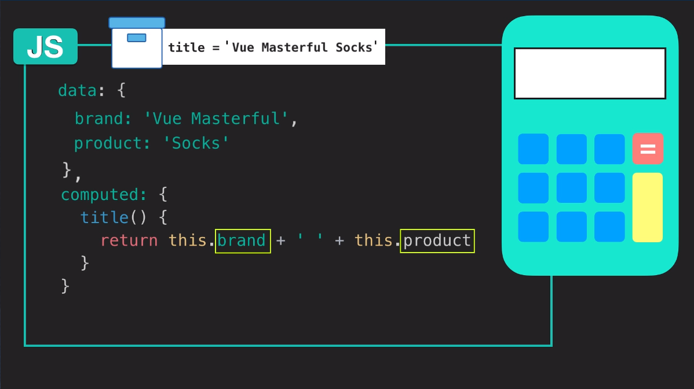

Slide 61
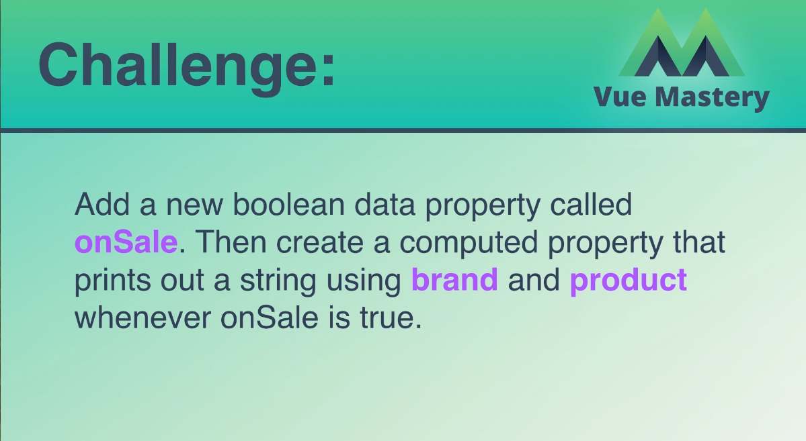
onSale이라는 boolean data property를 추가하십시오.
그런 다음 onSale이 true 일 때마다 brand 와 product을 합성한 string을 출력하는 computed property를 작성하십시오.

Slide 62
Components
Index8.html, Index8.js
<!DOCTYPE html>
<html>
<head>
<title>Product App</title>
<link rel="stylesheet" type="text/css" href="style2.css">
</head>
<body>
<div class="nav-bar"></div>
<div id="app">
<product premium="premium"></product>
<product></product>
<product></product>
</div>
<script src="https://cdn.jsdelivr.net/npm/vue@2.5.13/dist/vue.js"></script>
<script src="index8.js"></script>
</body>
</html>

Slide 63
Index8.js
Vue.component('product', {
props: {
premium: {
type: Boolean,
requried: true
}
},
template: `
<div class="product">
<div class="product-image">
<img v-bind:src="image" />
<!-- <img :src="image2" :alt="altText"/> -->
</div>
<div class="product-info">
<!-- <h1>{{ brand }} {{ product }}</h1> -->
<h1>{{ title }}</h1>
<p v-if="inStock">In Stock</p>
<p v-else
:class="{ outOfStock: !inStock }">Out of Stock</p>
<!-- <p v-if="inventory > 10">In Stock</p>
<p v-else-if="inventory<=10 && inventory >0">Almost sold out!</p>
<p v-else
:class="{ outOfStock: inventory <=0 }">Out of Stock</p> -->
<!-- <p v-show="inStock">In Stock</p> -->
<!-- <span v-if="onSale">On Sale!</span> -->
<!-- <p>{{ sale }}</p> -->
<p>Shipping: {{ shipping }}</p>
<ul>
<li v-for="detail in details">{{ detail }}</li>
</ul>
<!-- <div v-for="variant in variants" -->
<div v-for="(variant, index) in variants"
:key="variant.variantId"
class="color-box"
:style="{ backgroundColor: variant.variantColor }"
@mouseover="updateProduct(index)">
<!-- <p> {{ variant.variantColor }}</p> -->
<!-- <p @mouseover="updateProduct(variant.variantImage)"> {{ variant.variantColor }}</p> -->
</div>
<!-- <button v-on:click="cart += 1">Add to Cart</button> -->
<!-- <button v-on:click="addToCart">Add to Cart</button> -->
<button v-on:click="addToCart"
:disabled="!inStock"
:class="{ disabledButton: !inStock }">Add to Cart</button>
<!-- <button v-on:click="removeFromCart">Remove from cart</button> -->
<button v-on:click="removeFromCart"
:class="{ disabledButton: cart <= 0 }">Remove from cart</button>
<div class="cart">
<p>Cart({{cart}})</p>
</div>
</div>
</div>
`,
data() {
return {
brand: 'Vue Mastery',
product: 'Socks',
discription: 'Socks is footwear',
// image: "./assets/vmSocks-green-onWhite.jpg",
selectedVariant: 0,
altText: "A pair of socks",
// inStock: true,
// inventory: 11,
onSale: false,
details: ['80% cotton', '20% polyester', 'Gender-neutral'],
variants: [
{
variantId: 2234,
variantColor: "green",
variantImage: './assets/vmSocks-green-onWhite.jpg',
variantQuantity: 10
},
{
variantId: 2235,
variantColor: "blue",
variantImage: './assets/vmSocks-blue-onWhite.jpg',
variantQuantity: 0
}
],
cart: 0
}
},
methods: {
// addToCart: function () {
// this.cart += 1
// },
// updateProduct: function (variantImage) {
// this.image = variantImage
// }
addToCart() {
this.cart += 1
},
// updateProduct(variantImage) {
// this.image = variantImage
// },
updateProduct(index) {
this.selectedVariant = index
console.log(index)
},
removeFromCart() {
if (this.cart > 0) {
this.cart -= 1
}
}
},
computed: {
title() {
return this.brand + ' ' + this.product
},
image() {
return this.variants[this.selectedVariant].variantImage
},
inStock() {
return this.variants[this.selectedVariant].variantQuantity
},
sale() {
if (this.onSale) {
return this.brand + ' ' + this.product + ' are on sale!'
}
return this.brand + ' ' + this.product + ' are not on sale'
},
shipping() {
if (this.premium) {
return "Free"
}
return 2.99
}
}
})
//Add a description to the data object with the value "A pair of warm, fuzzy socks". Then display the description using an expression in an p element, underneath the h1.
var app = new Vue({
el: '#app',
data: {
premium: true
}
})

Slide 64
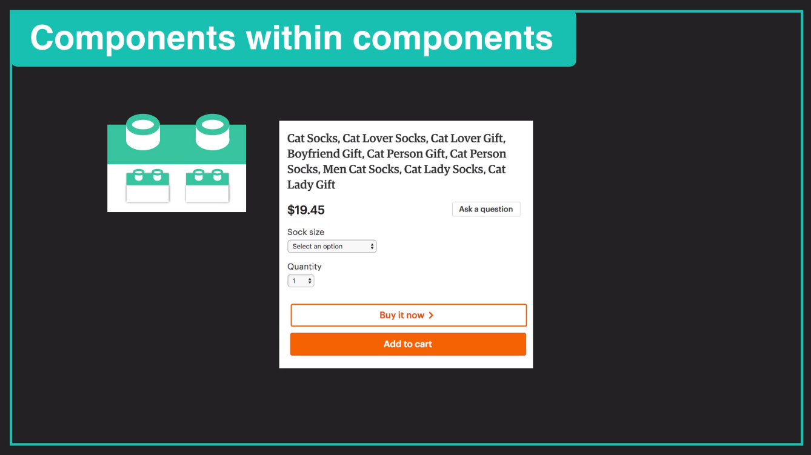

Slide 65
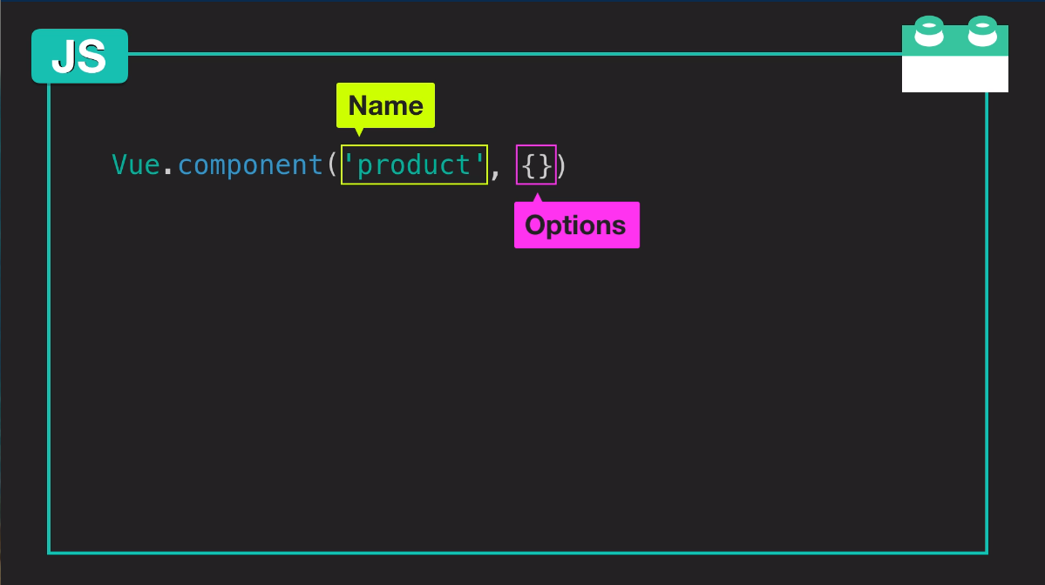

Slide 66
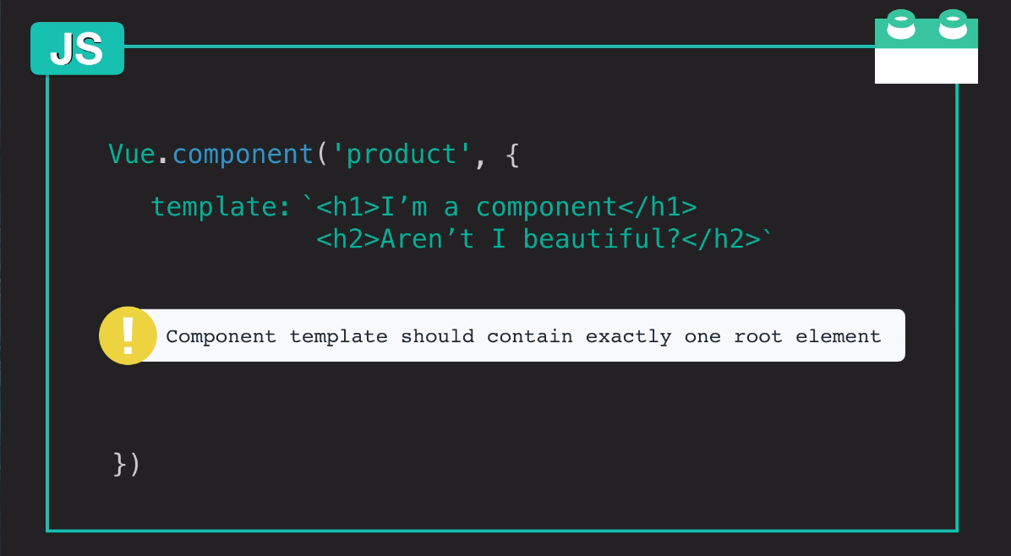

Slide 67
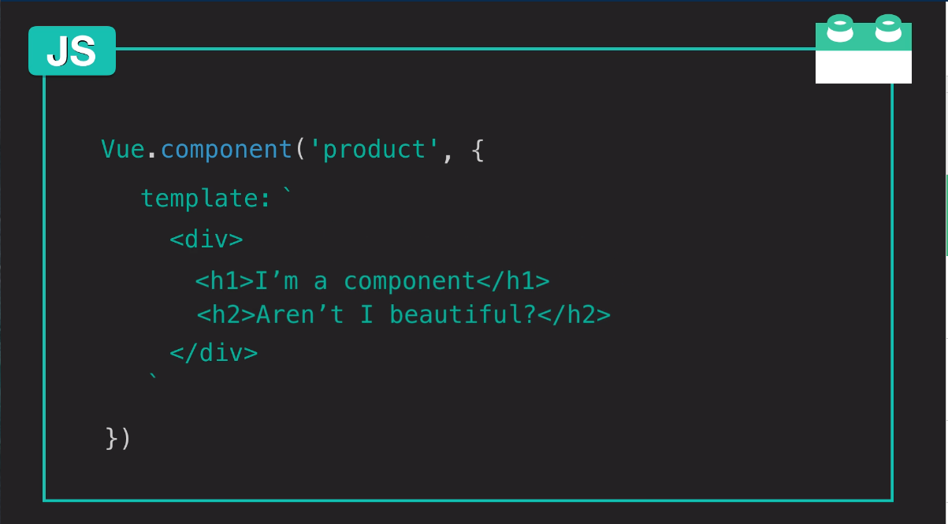

Slide 68
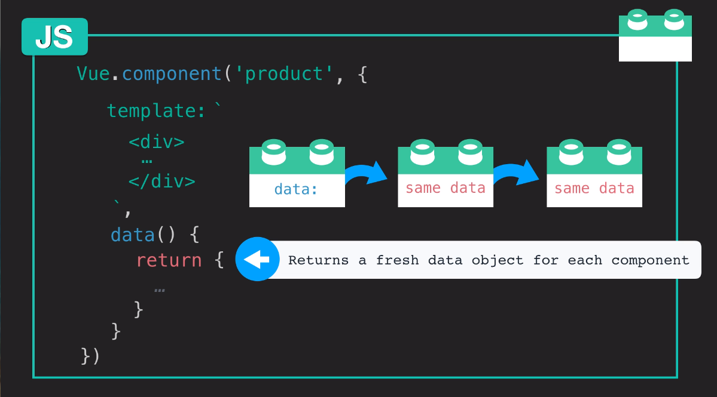

Slide 69
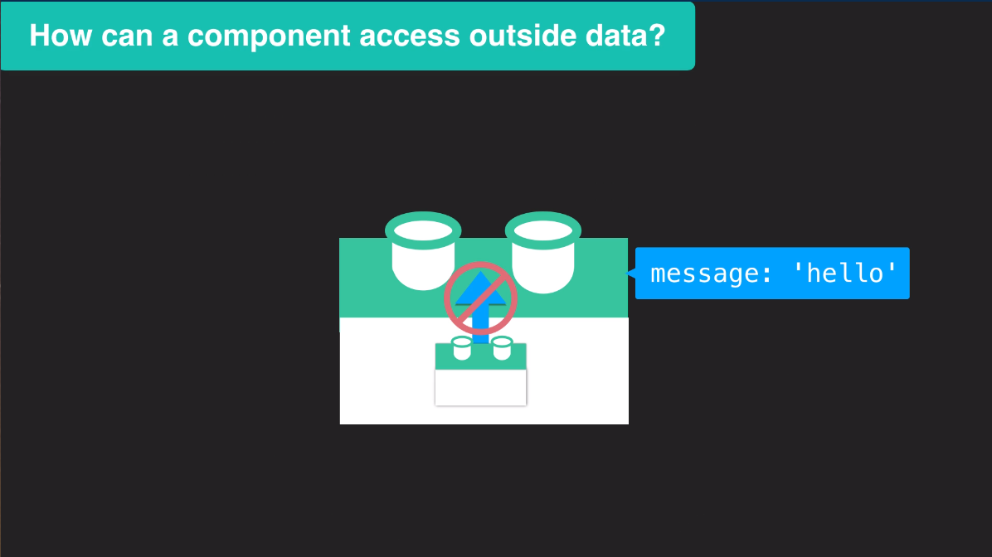

Slide 70
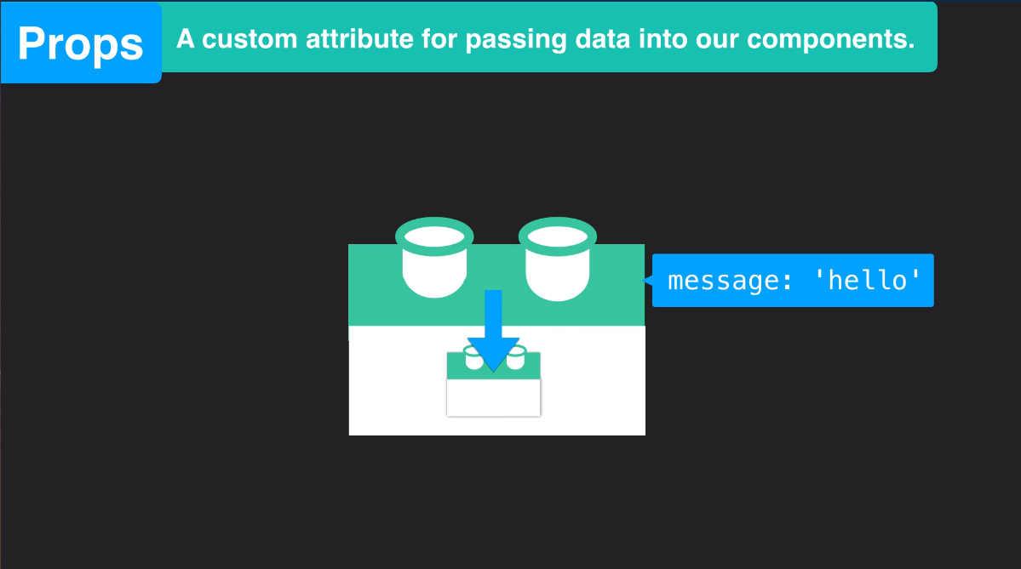

Slide 71
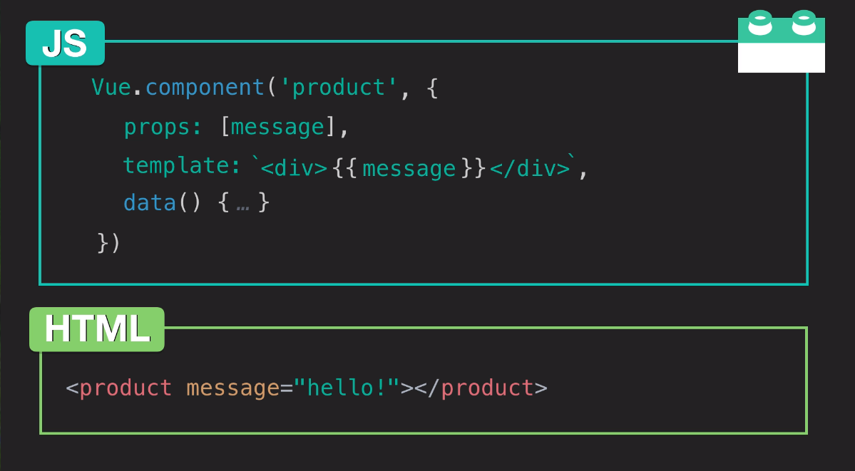

Slide 72
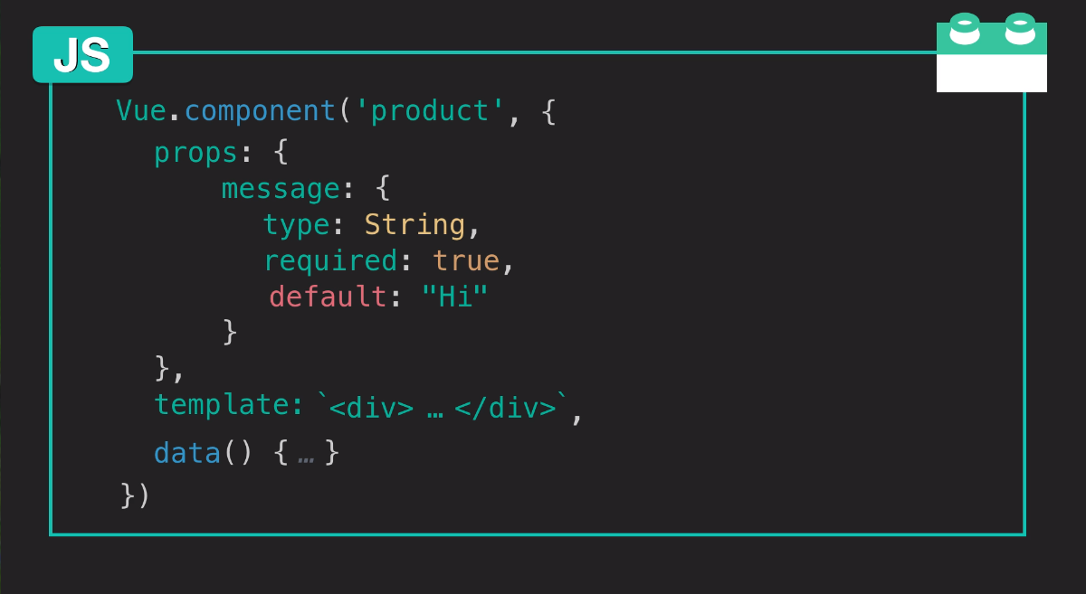

Slide 73
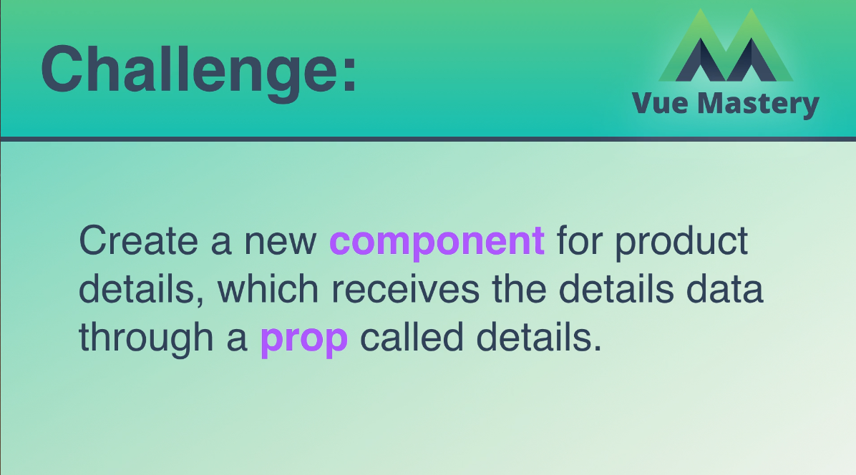
prop을 통해 details Array를 수신하는
product-details 라는 새로운 component를 작성하십시오.

Slide 74
https://medium.com/js-dojo/7-ways-to-define-a-component-template-in-vuejs-c04e0c72900d
https://kr.vuejs.org/v2/guide/single-file-components.html

Slide 75
Communicating Events
Index9.html, Index9.js
<!DOCTYPE html>
<html>
<head>
<title>Product App</title>
<link rel="stylesheet" type="text/css" href="style2.css">
</head>
<body>
<div class="nav-bar"></div>
<div id="app">
<div class="cart">
<!-- <p>Cart({{ cart.length }})</p> -->
<p>Cart({{ cart }})</p>
</div>
<product premium="premium" @add-to-cart="updateCart"></product>
</div>
<script src="https://cdn.jsdelivr.net/npm/vue@2.5.13/dist/vue.js"></script>
<script src="index9.js"></script>
</body>
</html>

Slide 76
Index9.js
Vue.component('product', {
props: {
premium: {
type: Boolean,
requried:true
}
},
template: `
<div class="product">
<div class="product-image">
<img v-bind:src="image" />
<!-- <img :src="image2" :alt="altText"/> -->
</div>
<div class="product-info">
<!-- <h1>{{ brand }} {{ product }}</h1> -->
<h1>{{ title }}</h1>
<p v-if="inStock">In Stock</p>
<p v-else
:class="{ outOfStock: !inStock }">Out of Stock</p>
<!-- <p v-if="inventory > 10">In Stock</p>
<p v-else-if="inventory<=10 && inventory >0">Almost sold out!</p>
<p v-else
:class="{ outOfStock: inventory <=0 }">Out of Stock</p> -->
<!-- <p v-show="inStock">In Stock</p> -->
<!-- <span v-if="onSale">On Sale!</span> -->
<!-- <p>{{ sale }}</p> -->
<p>Shipping: {{ shipping }}</p>
<ul>
<li v-for="detail in details">{{ detail }}</li>
</ul>
<!-- <div v-for="variant in variants" -->
<div v-for="(variant, index) in variants"
:key="variant.variantId"
class="color-box"
:style="{ backgroundColor: variant.variantColor }"
@mouseover="updateProduct(index)">
<!-- <p> {{ variant.variantColor }}</p> -->
<!-- <p @mouseover="updateProduct(variant.variantImage)"> {{ variant.variantColor }}</p> -->
</div>
<!-- <button v-on:click="cart += 1">Add to Cart</button> -->
<!-- <button v-on:click="addToCart">Add to Cart</button> -->
<button v-on:click="addToCart"
:disabled="!inStock"
:class="{ disabledButton: !inStock }">Add to Cart</button>
<!-- <button v-on:click="removeFromCart">Remove from cart</button> -->
<!-- <button v-on:click="removeFromCart"
:class="{ disabledButton: cart <= 0 }">Remove from cart</button> -->
</div>
</div>
`,
data() {
return {
brand: 'Vue Mastery',
product: 'Socks',
discription: 'Socks is footwear',
// image: "./assets/vmSocks-green-onWhite.jpg",
selectedVariant: 0,
altText: "A pair of socks",
// inStock: true,
// inventory: 11,
onSale: false,
details: ['80% cotton', '20% polyester', 'Gender-neutral'],
variants: [
{
variantId: 2234,
variantColor: "green",
variantImage: './assets/vmSocks-green-onWhite.jpg',
variantQuantity: 10
},
{
variantId: 2235,
variantColor: "blue",
variantImage: './assets/vmSocks-blue-onWhite.jpg',
variantQuantity: 0
}
]
}
},
methods: {
// addToCart: function () {
// this.cart += 1
// },
// updateProduct: function (variantImage) {
// this.image = variantImage
// }
addToCart() {
this.$emit('add-to-cart')
// this.$emit('add-to-cart', this.variants[this.selectedVariant].variantId)
},
// updateProduct(variantImage) {
// this.image = variantImage
// },
updateProduct(index) {
this.selectedVariant = index
console.log(index)
},
removeFromCart() {
if (this.cart > 0) {
this.cart -= 1
}
}
},
computed: {
title() {
return this.brand + ' ' + this.product
},
image() {
return this.variants[this.selectedVariant].variantImage
},
inStock() {
return this.variants[this.selectedVariant].variantQuantity
},
sale() {
if (this.onSale) {
return this.brand + ' ' + this.product + ' are on sale!'
}
return this.brand + ' ' + this.product + ' are not on sale'
},
shipping() {
if (this.premium) {
return "Free"
}
return 2.99
}
}
})
//Add a description to the data object with the value "A pair of warm, fuzzy socks". Then display the description using an expression in an p element, underneath the h1.
var app = new Vue({
el: '#app',
data: {
premium: true,
cart: 0
// cart: []
},
methods: {
updateCart() {
// updateCart(id) {
this.cart += 1
// this.cart.push(id)
}
}
})

Slide 77
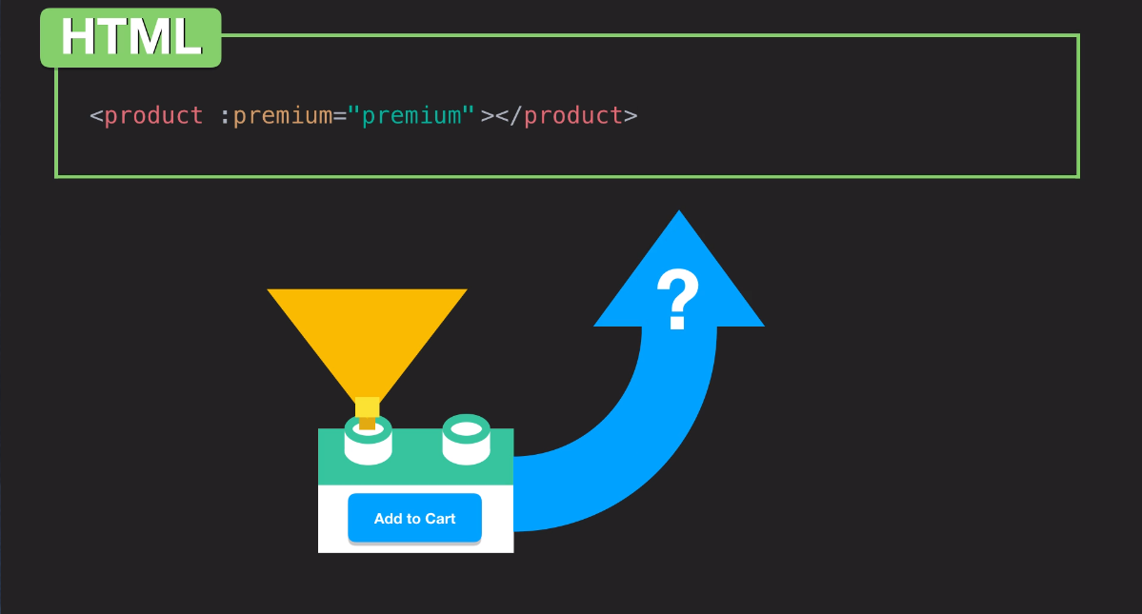

Slide 78
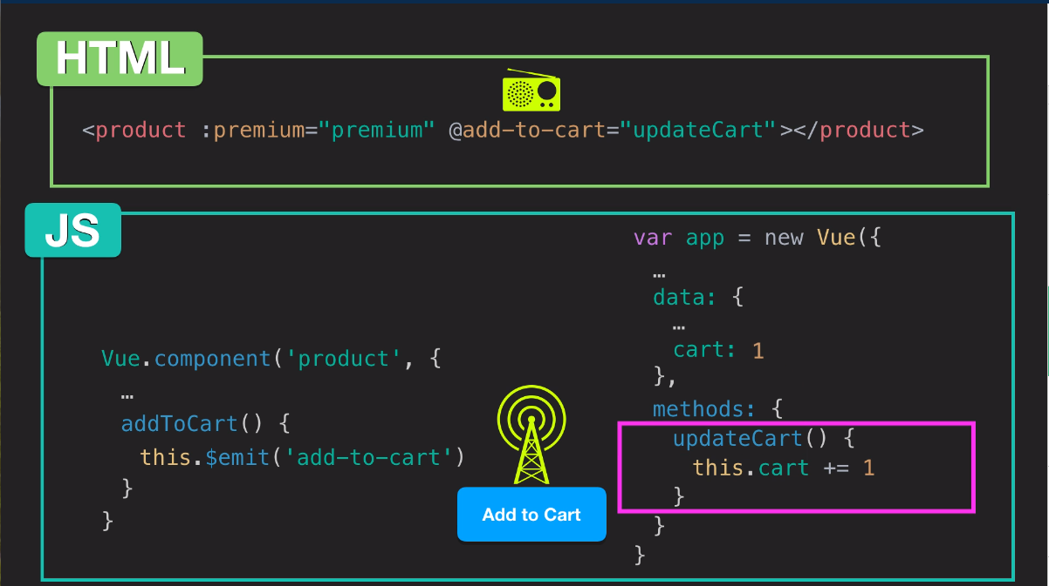

Slide 79

제거 할 product의 ID로 이벤트를 발생시켜
카트 array 에서 product을 제거하는 button을 추가하십시오.

Slide 80
Forms
Index10.html, Index10.js
<!DOCTYPE html>
<html>
<head>
<title>Product App</title>
<link rel="stylesheet" type="text/css" href="style2.css">
</head>
<body>
<div class="nav-bar"></div>
<div id="app">
<div class="cart">
<p>Cart({{ cart.length }})</p>
</div>
<product premium="premium" @add-to-cart="updateCart" @remove-from-cart="removeItem"></product>
</div>
<script src="https://cdn.jsdelivr.net/npm/vue@2.5.13/dist/vue.js"></script>
<script src="index10.js"></script>
</body>
</html>

Slide 81
Index10.js
Vue.component('product', {
props: {
premium: {
type: Boolean,
requried:true
}
},
template: `
<div class="product">
<div class="product-image">
<img v-bind:src="image" />
<!-- <img :src="image2" :alt="altText"/> -->
</div>
<div class="product-info">
<!-- <h1>{{ brand }} {{ product }}</h1> -->
<h1>{{ title }}</h1>
<p v-if="inStock">In Stock</p>
<p v-else
:class="{ outOfStock: !inStock }">Out of Stock</p>
<!-- <p v-if="inventory > 10">In Stock</p>
<p v-else-if="inventory<=10 && inventory >0">Almost sold out!</p>
<p v-else
:class="{ outOfStock: inventory <=0 }">Out of Stock</p> -->
<!-- <p v-show="inStock">In Stock</p> -->
<!-- <span v-if="onSale">On Sale!</span> -->
<!-- <p>{{ sale }}</p> -->
<p>Shipping: {{ shipping }}</p>
<ul>
<li v-for="detail in details">{{ detail }}</li>
</ul>
<!-- <div v-for="variant in variants" -->
<div v-for="(variant, index) in variants"
:key="variant.variantId"
class="color-box"
:style="{ backgroundColor: variant.variantColor }"
@mouseover="updateProduct(index)">
<!-- <p> {{ variant.variantColor }}</p> -->
<!-- <p @mouseover="updateProduct(variant.variantImage)"> {{ variant.variantColor }}</p> -->
</div>
<!-- <button v-on:click="cart += 1">Add to Cart</button> -->
<!-- <button v-on:click="addToCart">Add to Cart</button> -->
<button v-on:click="addToCart"
:disabled="!inStock"
:class="{ disabledButton: !inStock }">Add to Cart</button>
<!-- <button v-on:click="removeFromCart">Remove from cart</button> -->
<button @click="removeFromCart">Remove from cart</button>
</div>
<div>
<h2>Reviews</h2>
<p v-if="!reviews.length">There are no reviews yet.</p>
<ul>
<li v-for="review in reviews">
<p> {{ review.name }} </p>
<p>Rating : {{ review.rating }} </p>
<p> {{ review.review }} </p>
</li>
</ul>
</div>
<product-review @review-submitted="addReview"></product-review>
</div>
`,
data() {
return {
brand: 'Vue Mastery',
product: 'Socks',
discription: 'Socks is footwear',
// image: "./assets/vmSocks-green-onWhite.jpg",
selectedVariant: 0,
altText: "A pair of socks",
// inStock: true,
// inventory: 11,
onSale: false,
details: ['80% cotton', '20% polyester', 'Gender-neutral'],
variants: [
{
variantId: 2234,
variantColor: "green",
variantImage: './assets/vmSocks-green-onWhite.jpg',
variantQuantity: 10
},
{
variantId: 2235,
variantColor: "blue",
variantImage: './assets/vmSocks-blue-onWhite.jpg',
variantQuantity: 0
}
],
reviews: []
}
},
methods: {
// addToCart: function () {
// this.cart += 1
// },
// updateProduct: function (variantImage) {
// this.image = variantImage
// }
addToCart() {
this.$emit('add-to-cart', this.variants[this.selectedVariant].variantId)
},
removeFromCart() {
this.$emit('remove-from-cart', this.variants[this.selectedVariant].variantId)
},
updateProduct(index) {
this.selectedVariant = index
console.log(index)
},
addReview(productReview) {
this.reviews.push(productReview)
}
},
computed: {
title() {
return this.brand + ' ' + this.product
},
image() {
return this.variants[this.selectedVariant].variantImage
},
inStock() {
return this.variants[this.selectedVariant].variantQuantity
},
sale() {
if (this.onSale) {
return this.brand + ' ' + this.product + ' are on sale!'
}
return this.brand + ' ' + this.product + ' are not on sale'
},
shipping() {
if (this.premium) {
return "Free"
}
return 2.99
}
}
})
Vue.component('product-review', {
template: `
<form class="review-form" @submit.prevent="onSubmit">
<p class="error" v-if="errors.length">
<b>Please correct the following error(s):</b>
<ul>
<li v-for="error in errors">{{ error }}</li>
</ul>
</p>
<p>
<label for="name">Name:</label>
<input id="name" v-model="name">
</p>
<p>
<label for="review">Review:</label>
<textarea id="review" v-model="review" required></textarea>
</p>
<p>
<label for="rating">Rating:</label>
<select id="rating" v-model.number="rating">
<option>5</option>
<option>4</option>
<option>3</option>
<option>2</option>
<option>1</option>
</select>
</p>
<p>
<input type="submit" value="Submit">
</p>
</form>
`,
data() {
return {
name: null,
review: null,
rating: null,
errors: []
}
},
methods: {
onSubmit() {
if (this.name && this.review && this.rating) {
let productReview = {
name: this.name,
review: this.review,
rating: this.rating
}
this.$emit('review-submitted', productReview)
this.name = null
this.review = null
this.rating = null
} else {
if(!this.name) this.errors.push("Name Required.")
if(!this.review) this.errors.push("Review Required.")
if(!this.rating) this.errors.push("Rating Required.")
}
}
}
})
//Add a description to the data object with the value "A pair of warm, fuzzy socks". Then display the description using an expression in an p element, underneath the h1.
var app = new Vue({
el: '#app',
data: {
premium: true,
cart: []
},
methods: {
updateCart(id) {
this.cart.push(id)
},
removeItem(id) {
for(var i = this.cart.length - 1; i >= 0; i--) {
if (this.cart[i] === id) {
this.cart.splice(i, 1);
}
}
}
}
})

Slide 82


Slide 83

Form에 질문을 추가하십시오.
"이 제품을 추천 하시겠습니까?"
radio button를 사용하여 응답을 가져 와서
form Validation을 통해 productReview 오브젝트에 추가하십시오.

Slide 84
Tabs
Index11.html, Index11.js
<!DOCTYPE html>
<html>
<head>
<title>Product App</title>
<link rel="stylesheet" type="text/css" href="style2.css">
</head>
<body>
<div class="nav-bar"></div>
<div id="app">
<div class="cart">
<p>Cart({{ cart.length }})</p>
</div>
<product premium="premium" @add-to-cart="updateCart" @remove-from-cart="removeItem"></product>
</div>
<script src="https://cdn.jsdelivr.net/npm/vue@2.5.13/dist/vue.js"></script>
<script src="index11.js"></script>
</body>
</html>

Slide 85
Index11.js
var eventBus = new Vue()
Vue.component('product', {
props: {
premium: {
type: Boolean,
requried:true
}
},
template: `
<div class="product">
<div class="product-image">
<img v-bind:src="image" />
<!-- <img :src="image2" :alt="altText"/> -->
</div>
<div class="product-info">
<!-- <h1>{{ brand }} {{ product }}</h1> -->
<h1>{{ title }}</h1>
<p v-if="inStock">In Stock</p>
<p v-else
:class="{ outOfStock: !inStock }">Out of Stock</p>
<!-- <p v-if="inventory > 10">In Stock</p>
<p v-else-if="inventory<=10 && inventory >0">Almost sold out!</p>
<p v-else
:class="{ outOfStock: inventory <=0 }">Out of Stock</p> -->
<!-- <p v-show="inStock">In Stock</p> -->
<!-- <span v-if="onSale">On Sale!</span> -->
<!-- <p>{{ sale }}</p> -->
<p>Shipping: {{ shipping }}</p>
<ul>
<li v-for="detail in details">{{ detail }}</li>
</ul>
<!-- <div v-for="variant in variants" -->
<div v-for="(variant, index) in variants"
:key="variant.variantId"
class="color-box"
:style="{ backgroundColor: variant.variantColor }"
@mouseover="updateProduct(index)">
<!-- <p> {{ variant.variantColor }}</p> -->
<!-- <p @mouseover="updateProduct(variant.variantImage)"> {{ variant.variantColor }}</p> -->
</div>
<!-- <button v-on:click="cart += 1">Add to Cart</button> -->
<!-- <button v-on:click="addToCart">Add to Cart</button> -->
<button v-on:click="addToCart"
:disabled="!inStock"
:class="{ disabledButton: !inStock }">Add to Cart</button>
<!-- <button v-on:click="removeFromCart">Remove from cart</button> -->
<button @click="removeFromCart">Remove from cart</button>
</div>
<product-tabs :reviews="reviews"></product-tabs>
</div>
`,
data() {
return {
brand: 'Vue Mastery',
product: 'Socks',
discription: 'Socks is footwear',
// image: "./assets/vmSocks-green-onWhite.jpg",
selectedVariant: 0,
altText: "A pair of socks",
// inStock: true,
// inventory: 11,
onSale: false,
details: ['80% cotton', '20% polyester', 'Gender-neutral'],
variants: [
{
variantId: 2234,
variantColor: "green",
variantImage: './assets/vmSocks-green-onWhite.jpg',
variantQuantity: 10
},
{
variantId: 2235,
variantColor: "blue",
variantImage: './assets/vmSocks-blue-onWhite.jpg',
variantQuantity: 0
}
],
reviews: []
}
},
methods: {
// addToCart: function () {
// this.cart += 1
// },
// updateProduct: function (variantImage) {
// this.image = variantImage
// }
addToCart() {
this.$emit('add-to-cart', this.variants[this.selectedVariant].variantId)
},
removeFromCart() {
this.$emit('remove-from-cart', this.variants[this.selectedVariant].variantId)
},
updateProduct(index) {
this.selectedVariant = index
console.log(index)
}
},
computed: {
title() {
return this.brand + ' ' + this.product
},
image() {
return this.variants[this.selectedVariant].variantImage
},
inStock() {
return this.variants[this.selectedVariant].variantQuantity
},
sale() {
if (this.onSale) {
return this.brand + ' ' + this.product + ' are on sale!'
}
return this.brand + ' ' + this.product + ' are not on sale'
},
shipping() {
if (this.premium) {
return "Free"
}
return 2.99
}
},
mounted() {
eventBus.$on('review-submitted', productReview => {
this.reviews.push(productReview)
})
}
})
Vue.component('product-review', {
template: `
<form class="review-form" @submit.prevent="onSubmit">
<p class="error" v-if="errors.length">
<b>Please correct the following error(s):</b>
<ul>
<li v-for="error in errors">{{ error }}</li>
</ul>
</p>
<p>
<label for="name">Name:</label>
<input id="name" v-model="name">
</p>
<p>
<label for="review">Review:</label>
<textarea id="review" v-model="review" required></textarea>
</p>
<p>
<label for="rating">Rating:</label>
<select id="rating" v-model.number="rating">
<option>5</option>
<option>4</option>
<option>3</option>
<option>2</option>
<option>1</option>
</select>
</p>
<p>Would you recommend this product?</p>
<label>
Yes
<input type="radio" value="Yes" v-model="recommend"/>
</label>
<label>
No
<input type="radio" value="No" v-model="recommend"/>
</label>
<p>
<input type="submit" value="Submit">
</p>
</form>
`,
data() {
return {
name: null,
review: null,
rating: null,
recommend: null,
errors: []
}
},
methods: {
onSubmit() {
if (this.name && this.review && this.rating) {
let productReview = {
name: this.name,
review: this.review,
rating: this.rating,
recommend: this.recommend
}
eventBus.$emit('review-submitted', productReview)
this.name = null
this.review = null
this.rating = null
this.recommend = null
} else {
if(!this.name) this.errors.push("Name Required.")
if(!this.review) this.errors.push("Review Required.")
if(!this.rating) this.errors.push("Rating Required.")
if(!this.recommend) this.errors.push("Recommend Required.")
}
}
}
})
Vue.component('product-tabs', {
props: {
reviews: {
type: Array,
required: true
}
},
template: `
<div>
<span class="tab"
:class="{ activeTab: selectedTab === tab }"
v-for="(tab, index) in tabs"
:key="index"
@click="selectedTab = tab">
{{ tab }}</span>
<div>
<h2>Reviews</h2>
<div v-show="selectedTab === 'Reviews'">
<p v-if="!reviews.length">There are no reviews yet.</p>
<ul>
<li v-for="review in reviews">
<p> {{ review.name }} </p>
<p>Rating : {{ review.rating }} </p>
<p> {{ review.review }} </p>
<p>Recommed : {{ review.recommend }} </p>
</li>
</ul>
</div>
</div>
<product-review v-show="selectedTab === 'Make a Review'"></product-review>
</div>
`,
data() {
return {
tabs: ['Reviews', 'Make a Review'],
selectedTab: 'Reviews'
}
}
})
//Add a description to the data object with the value "A pair of warm, fuzzy socks". Then display the description using an expression in an p element, underneath the h1.
var app = new Vue({
el: '#app',
data: {
premium: true,
cart: []
},
methods: {
updateCart(id) {
this.cart.push(id)
},
removeItem(id) {
for(var i = this.cart.length - 1; i >= 0; i--) {
if (this.cart[i] === id) {
this.cart.splice(i, 1);
}
}
}
}
})

Slide 86
https://kr.vuejs.org/v2/guide/forms.html
https://kr.vuejs.org/v2/guide/events.html

Slide 87

Shipping cost 및 details을 각각 표시하는
“Shipping"및 “Detail＂Tap을 작성하십시오.

